Slide 1
Diagnosis: It’s Only the Tip of the Iceberg
Presented by: Penny Liles, MS, CRC, LCMHC
UNC-CH Institute for Best Practices

Slide 2
Objectives
Identify what disclosure is and why it is important.
Describe the specifics of the disclosure conversation.
Apply the disclosure conversation to case studies.

Slide 3
What is Disclosure?
Sharing information
Making something known
Notes:
First Ask: how do they determine what and how much they share with other people in their lives, work, etc.?
Emphasize that we control the information we share with others…we decide who, what, when, where…relate back to people served.
Once something is shared this information cannot be “taken back” (There’s no Back to The Future Moment, a pause button, a rewind, etc. ) so it is imperative that we thoroughly explain what disclosure is and truly understand a person’s preferences and needs.
Some people might not know what disclosure means. May have to redefine it when talking to people.
Also, this is a very personal conversation. It is important to show individuals that you are not afraid to talk about personal information with them and respect their choice to share or not to share. This conversation has the ability to be a great rapport builder and demonstrate trust with people.

Slide 4
What would you say?
You have been invited to your supervisor’s 50th birthday party and you were picked to give the toast. On the day of the event, you got sick, and had to cancel. When you called to cancel, would you say:
I cannot come because I have a kidney stone OR because I am depressed and suicidal?
I hurt my back OR I am having a panic attack?
I am having a migraine headache OR I am high on pain medication?
Notes:
Activity taken from Ted Talk at: https://www.youtube.com/watch?v=WrbTbB9tTtA
There is a lot of stigma around mental health. There is still a lot to learn about mental illness because the brain is so complicated.
Because of it, people do not seek out treatment or tell others about being in treatment.
If you chose the medical/physical condition, some stigma about mental health and/or substance use exists in you.

Slide 5
Notes:
Watch 2:41 and discuss
https://www.youtube.com/watch?v=8FPqeYFYBKE

Slide 7
Negative Attitudes Leads to FEAR
Media & Violence
Belief of Undesirable behaviors & Unpredictability
Belief of less reliable
Importance of Supportive Managers & Organizational Policies & Practices
Training about mental health and how to support
Need to be more benefits to disclosure than risks
(Dewa, 2014)
Notes:
First bullet point
Workers may be hesitant to ask for support—may be due to not recognizing need and/or the vulnerability to stigma as it relates to disclosing to others
Negative Attitudes in the media has led to fear (esp in American films); also association of MH & Violence—leads to further belief in people with MH challenges have undesirable behaviors, unpredictability, less reliable
Second bullet point
Even concern of negative judgement of self to disclose because to speak is to acknowledge
One factor that impacts whether people disclose is the safe and security of the work environment

Slide 8
Public attitudes improve when having contact with someone diagnosed with a mental illness
Analyzing the Considerations:
Personal Considerations
Considerations Involving a Potential or Actual Employer
Societal Issues At the time you are considering disclosure
(Dewa, 2014)
Notes:
Though having celebrities share their stories are important…it has been found that people are more challenged when it is someone they “know”—coming from their own community
1) Personal Considerations:
how well you feel you can handle prejudice and discrimination
prior experience or discrimination that you or colleagues experienced
your sense of self (including culture)
your employment history
how well you feel you can handle maintaining a secret—and sometimes having to lie to do so Sense of disability pride or identity other identity issues—including race, gender, culture, and age.
2) Considerations Involving a Potential or Actual Employer type of business (e.g., whether prejudice is more or less likely):
size of employer (e.g., large company vs. small mom and pop business)
whether there are other persons with disabilities employed there
whether it appears the employer has adequately accommodated persons with other disabilities
whether staff or supervisors make positive or negative comments about people with disabilities, including those with psychiatric disabilities
how competitive the employment position is
how competitive the profession is (e.g., stockbroker)
how much expertise you bring to a particular job (e.g., if you are the only person in the metropolitan area who has this particular skill)
whether the particular accommodation request will be seen as problematic or as matter-of-fact (e.g., request for part-time hours may not be problematic since many employees work part-time)
whether staff and supervisors seem to be friendly to one another and to you.
Work environment (speak same language, sex of supervisor)
3) Societal Issues at the time you are considering disclosure:
has there been anything in the news or the media that might result in a period of increased prejudice?
has there been anything in the news or arts that might result in a period of decreased prejudice, for example, the movie A Beautiful Mind or a famous person disclosing a psychiatric disability

Slide 9
Disclosure is complex
Decision-Making skills tend to be diminished
Mixed Evidence of whether disclosure leads to better/worse employment outcomes
Accommodations related to increased employment duration
3 Different Approaches:
Binary
Multidimensional
Evolving & Ongoing
(Hielscher & Waghorn 2015)
Notes:
Importance of facilitating better disclosure decisions in the workplace—to improve IPS-SE
Been a lack of guidance on the disclosure conversation leading to over and under disclosure
When people have information disclosed for them—less typical job attainment than those who self-disclose—which lead to the Disclosure Item added to the fidelity scale
For people with an SPMI—decision making skills are diminished
Influenced by personal characteristics & circumstances, Employer characteristics, nature of position, and type of work place
3 Different Approaches:
Binary approach. The most common approach to the disclosure problem has been to conceptualize it as a binary decision— that is, one either discloses or does not disclose his or her mental health condition in the workplace. This is a very simple approach (yes or no) to a very complex problem
The multidimensional approach can be encouraging to people in recovery to consider the different strategies used by others, and the pros and cons of each. The strategies to consider include:
(a) full disclosure (reveal mental health condition to most or all in the workplace),
(b) strategically timed disclosure (disclose in the workplace after a period of time, e.g., after developing good work relationships),
(c) selective (partial) disclosure (sharing information with specific or a limited number of people),
(d) inadvertent (involuntary) disclosure (disclosure brought about by an employee presuming that the employer knows about his or her condition),
(e) forced (involuntary) disclosure (accidental disclosure brought about by either visible symptoms, hospitalizations, or carelessness),
(f) deception (distorting the circumstances of the condition in the workplace),
(g) targeted disclosure (disclosure as having a “lived experience” when this matches the job requirements, e.g., mental health worker), and
(h) avoidant nondisclosure (keeping information about your mental health private in the workplace
This evolving and ongoing approach has been proposed as an alternative to the binary concept of disclosure, and is an extension of the multidimensional approach that involves choosing from one of several disclosure strategies. An alternative conception is an understanding of disclosure as a fluid, ongoing, and evolving process.

Slide 10
Questions:
1. If I decide to disclose information about my mental illness, how should I do that?
2. And what is likely to happen to me at work if I do disclose?
Themes:
If part of a vocational program—hasn’t necessarily been the “worker” who has disclosed;
Workers more likely to have information disclosed have more noticeable/serious symptoms related to their illness (i.e., psychotic disorders rather than mood disorders);
Supervisors rather than Co-Workers;
Before and or Early in the Process
(Jones, 2011)
Notes:
Study set out to answer 2 questions
Disclosure has been difficult to study due to the complexities, definition, who ends up disclosing
Themes: If part of a vocational program—hasn’t not necessarily been the “worker” who has disclosed; Workers more likely to have information disclosed have more noticeable/serious symptoms related to their illness (i.e., psychotic disorders rather than mood disorders); Supervisors rather than Co-Workers; Before and or Early in the Process
Focus in Research has been on linking disclosure on the hiring process and job tenure and has been unclear as to the results: More positive if accompanied with a “job developer” to the interview
Importance of reviewing the pros/cons of disclosure to each person’s specific situation: Do they need accommodations?—Then May Be Helpful; If wanting to improve relationship or have a more supportive work environment?—More Risky

Slide 11
The Disclosure Conversation

Slide 12
Our Role In Disclosure
Elicit. Provide. Elicit.
Be mindful of providing too many “prompts” or giving direction
Remember, we are there to collaborate and partner with people
Pros & Cons of Disclosing and Not Disclosing
Notes:
2 mins
Dignity of risk : Honoring people's preferences
Remember the MI spirit – partnering, acceptance, collaborating, evocation.
Use OARS. Avoid the expert trap (we know all the answers and we know what the person should do. BUT WE DO NOT. We need to honor people's preferences).
Cannot force anyone into sharing any information. Even if WE think someone would benefit from (or NEEDS) to disclose/have direct contact with an employer, this is up to the individual. It can be incredibly empowering to do the job completely on your own.

Slide 13
Notes:
https://www.youtube.com/watch?v=mjNc8Mn_dB8
Video is 2:03 minutes and discuss

Slide 14
Pros & Cons
Should the Person Disclose? Why or Why not?
When?
What?
To Whom?
How?
Notes:
The Disclosure Conversation Includes:
Determine the Pros and Cons of Disclosure
Make the Decision
Finalize the Reasons
Determine when Disclosure should happen
Specific Information Needed to Disclose to Receive an Accommodation
Identify the person(s)
In what Format…DEVELOP A SCRIPT

Slide 15
Work Adjustments/ Accommodations
Financial benefits for the employers
On-Site assistance from ESP
‘Reasonable adjustments’ in the selection process
Providing incorrect information on a medical questionnaire could invalidate a job offer
Access additional funding to support you with equipment, etc.
Explain any possible gaps in your academic study &/or work history
Notes:
Before showing the slide…Ask the audience some of their thoughts of what the pros of disclosure might be. What have they heard from individuals?
Remind that this is not an exhaustive list and should be specific and personalized.

Slide 16
Stigma
Discrimination
May not get the job due to a “technicality”
Coworkers may devalue and/or undermine the individual
Lack of promotions and/or raises
Target of gossip and/or being rejected in the environment
Experiencing symptoms may be more stressful due to others “watching”
Notes:
Before showing the slide…Ask the audience some of their thoughts of what the cons of disclosure might be. What have they heard from individuals?
Remind that this is not an exhaustive list and should be specific and personalized

Slide 17
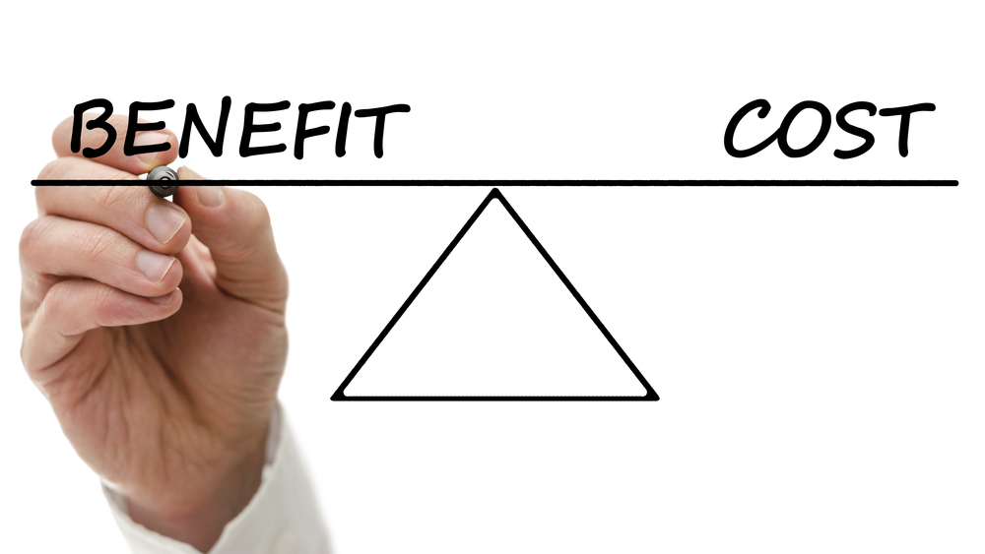
Pros
No risk for discrimination
No stigma attached
Respecting one's Personal Preference
Treated fairly & Equally
Cons
Unable to access workplace accommodations
May have to have the disclosure conversation with employer later
Notes:
In order to thoroughly examine the decision we must examine both perspectives of making the decision…whatever that might be. Another example would be: Do I want to buy a different house? Examine the pros and cons of staying and pros and cons of buying a different house.
Ask what might be some of the pros of NOT disclosing and some of the cons of NOT disclosing.
After discussing the content: Review 3 Poll Questions
Why do people disclose? a. To get an accommodation b. To educate the employer c. Explain gaps in work history d. All of the above
Why do people choose NOT to disclose?
A) Fear of stigma and discrimination
B) No need for accommodations
C) Want to get the job on their own
D) All of the above
Which is NOT part of the self-determination theory? a. Competence b. Relatedness c. Affirmation d. Self-endorsed

Slide 18
Pros & Cons
Notes:
Individual exercise. Pg. 1 of handouts.
Think about something you might disclose to someone: employer, significant other, family member.
Write down the pros and cons of sharing and not sharing. Which weighed the most to you? What did you decide to do?
Talk about the experience. What was it like? How did it make you feel?
Relate how personal this is for people. Keep this in mind when talking to people about disclosure. It's a big decision that shouldn't be taken lightly.

Slide 19
Common Job Concerns
Maintaining regular attendance
Dealing with the change of starting a new job
Nervousness about interacting with others
Understanding how to manage time
Organizing information
Handling stress and emotions
Maintaining focus
Notes:
Ask first
What are some concerns that you all have when starting a new job? What might be some of the concerns people with disabilities might have?
Not an exhaustive list. Help make connections/commonalities.

Slide 20
When Can Someone Disclose?
Application / Resume
Cover Letter
Pre-Interview
Interview
Offered the job
During employment
NEVER
Notes:
Mixed feelings about when is the right time to disclose. Why it is so critical to continue to discuss disclosure throughout?
Notes about each one…do not have to say all of this:
Application / Resume: disabilities in their résumé or letter of application. Having a disability may be viewed as a positive trait in some professions or even as a requirement for some positions. On the other hand, you might decide to use this as an opportunity to indicate that you have a disability that will not limit your performance if you are properly accommodated. Finally, you might just want to indicate that you would prefer to answer this question when you are called for an interview.
Cover Letter: Some individuals disclose their disabilities in their cover letters. As a rule, attach the cover letter to the back of your résumé so that your skills can be the focal point. Again, having a disability is not always a strike against you. Some companies actively recruit people with disabilities to meet Affirmative Action goals.
Pre-Interview: Disclosure prior to the interview is encouraged only when an accommodation is needed for the actual interview.
Interview: You might or might not choose to disclose your disability during an interview. If your disability is visible, you might wish to discuss your disability and how it will not get in the way of doing a good job, especially if you have proper accommodations. If your disability is not apparent (invisible), you will need to decide whether or not to disclose your disability based on your comfort and trust levels. You do not have to disclose your disability at this stage. However, it might be helpful to do so in order to show that you can do the job with the right accommodation. At this time, you might want to give examples. Be positive and upbeat; show your confidence in yourself. Don’t be apologetic, defensive, or cocky.
Offered Job: Many individuals choose to disclose their disabilities after they have been offered the job. They want to be selected for the position because of their skills, and worry that disclosure prior to the point may influence the interviewer’s decision. However, once hired, you might need accommodations to do the essential functions of the job. Also, if the job requires medical testing and you take medications that will show up in a screening, you may choose to disclose this to the employer at this time.
During Employment: Sometimes, individuals with disabilities do not recognize that their disabilities can negatively affect their job performance. This is especially true for youth getting their first full-time job. Sometimes, you may feel confident when you begin a job, but become concerned that you may have underestimated your need for an accommodation. Remember that it is your responsibility to ask for an accommodation if you need one. It is always better to ask for it before your job performance is questioned. Your employer cannot force an accommodation on you, but has the final word in what accommodation you will receive (after consulting with you, of course).
Never: If you are able to perform the essential functions of the job without reasonable accommodation, you need not disclose your disability.

Slide 21
What to disclose?
Start small
Different Types of Disclosure
Full
Partial
None
Notes:
Once information is out there you can't take it back! No rewind or do overs. If the person chooses to disclose, start small.
Talk through what each of the levels means.
Full: might include diagnosis name, specific symptoms, request for accommodations and why needed, agency working with and why
Partial: might include generic overview of symptoms and accommodations request, might include employment specialist helps me find and maintain work, but nothing specific.
None: self-explanatory, but gather information to give to the individual when job developing. Not necessary if the person does not need accommodations. Preference might change if there is a problem on the job.
There shouldn't be a high percentage on either side, should be spaced out fairly evenly amongst the three.

Slide 22
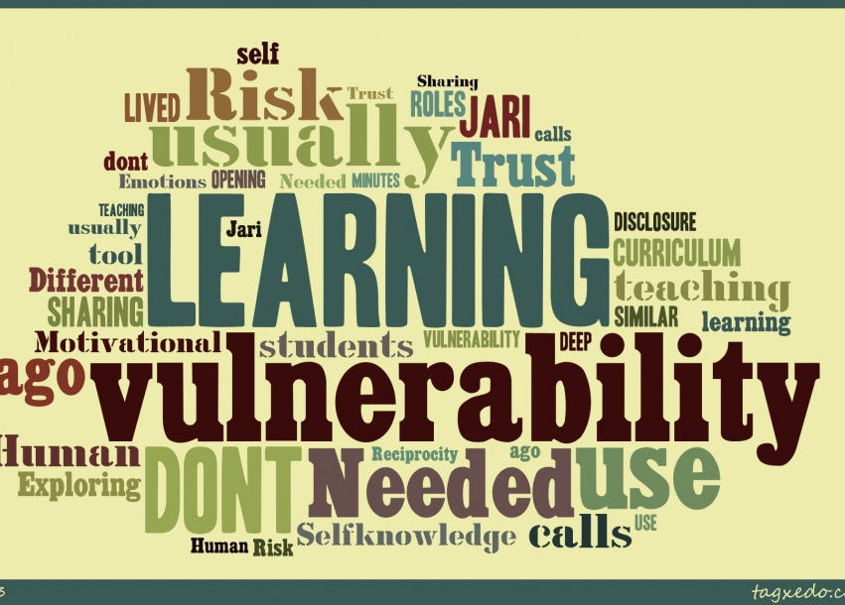
To Whom Should Receive Information?
Those who NEED to know
For Employment
Hiring Manager
Human Resources
Direct Manager
Disability-specific adult employment services personnel
For Education
Disability Support Services,
Directly to Faculty
Admissions officer
Career Counselors
Notes:
There could be others. And again-not everyone would need to know…just whoever has been identified to provide the accommodation.
But this does bring up the issue of whether people choose to disclose to co-workers & how that might impact their work experience/environment. Why might you not disclose to co-workers (e.g., gossip, stigma, discrimination, feeling watched/blamed for mishaps)

Slide 23
How Should I Disclose?
In person
Interview
Job offer
Formal meeting
Supervision meeting
Written
Cover letter
Formal letter
Email
Company forms
Medical records
Phone (in an emergency situation)
Notes:
Not an exhaustive list of how to disclose
***disclaimer about phone. Not the preferred way to disclose (i.e., seems impersonal and disconnected). This might happen if someone is calling about a medical or psychiatric emergency, calling from treatment facility or inpatient hospitalization. Will usually be followed up with written and/or in person disclosure.

Slide 24
Determine the Pros & Cons of Disclosure
Should the Person Disclose?
Why or Why not?
When?
What?
To Whom?
How?
Notes:
Break up into small groups.
Have each group 1-3 (depending on size) scenarios & complete the activity in the Disclosure sheet, pp. 2-4 in the handouts.
Discuss & Process the outcome in the larger group.

Slide 25
Why Should We Revisit Disclosure?
Preferences change over time
Managers change
Job duties change
Specific preferences depending on the job/employer
Better understanding of needing accommodations
Losing jobs
Inability to obtain a job
Experiencing Stigma or Discrimination
Notes:
Engage in brief discussion. Highlight some of the examples.

Slide 26
We ALL have Closets
Notes:
https://www.youtube.com/watch?v=kSR4xuU07sc
Watch video (about 5 minutes) and Discuss
***May have to make a disclaimer about not trying to make a political statement, but it is about the difficulty of sharing personal information

Slide 27
Personal and individualized decision
Complex with many considerations
Variances & diversity in degree of disclosure
Influenced by stigma and discrimination (past and present)
Should be related back to introduction to an employer or a person needs accommodations
Notes:
Considerations: personal, employer, and societal
Very multidimensional (not just pros and cons)
Disclosure is individualized and the conversations should not all look the same
Disclosure is only needed to introduce someone to an employer or request accommodations

Slide 28
References
Dewa, C.S. (2014). Worker Attitudes towards Mental Health Problems and Disclosure. International Journal of Occupational and Environmental Medicine, 5(4), 175-186.
Hielscher, E. and Waghorn, G. (2015). Managing Disclosure of Personal Information: An Opportunity to Enhance Supported Employment. Psychiatric Rehabilitation Journal, 38(4), 306-313.
Jones, A.M. (2011). Disclosure of Mental Illness in the Workplace: A Literature Review. American Journal of Psychiatric Rehabilitation, 14, 212-229.
Swanson, S.J., Langfitt-Reese, S., Bond, G.R. (2012). Employer Attitudes About Criminal Histories. Psychiatric Rehabilitation Journal, 35(5), 385-390.

Slide 29
Contact Information: penny_liles@med.unc.edu

