Slide 1
Inaugural European IPS Meeting 22nd April 2021 by ZOOM
Switzerland
Dirk Richter – Bern University Hospital for Mental Health/Bern University of Applied Sciences
Wolfram Kawohl – Clienia Schloessli Hospital/Psychiatric University Hospital Zurich

Slide 2
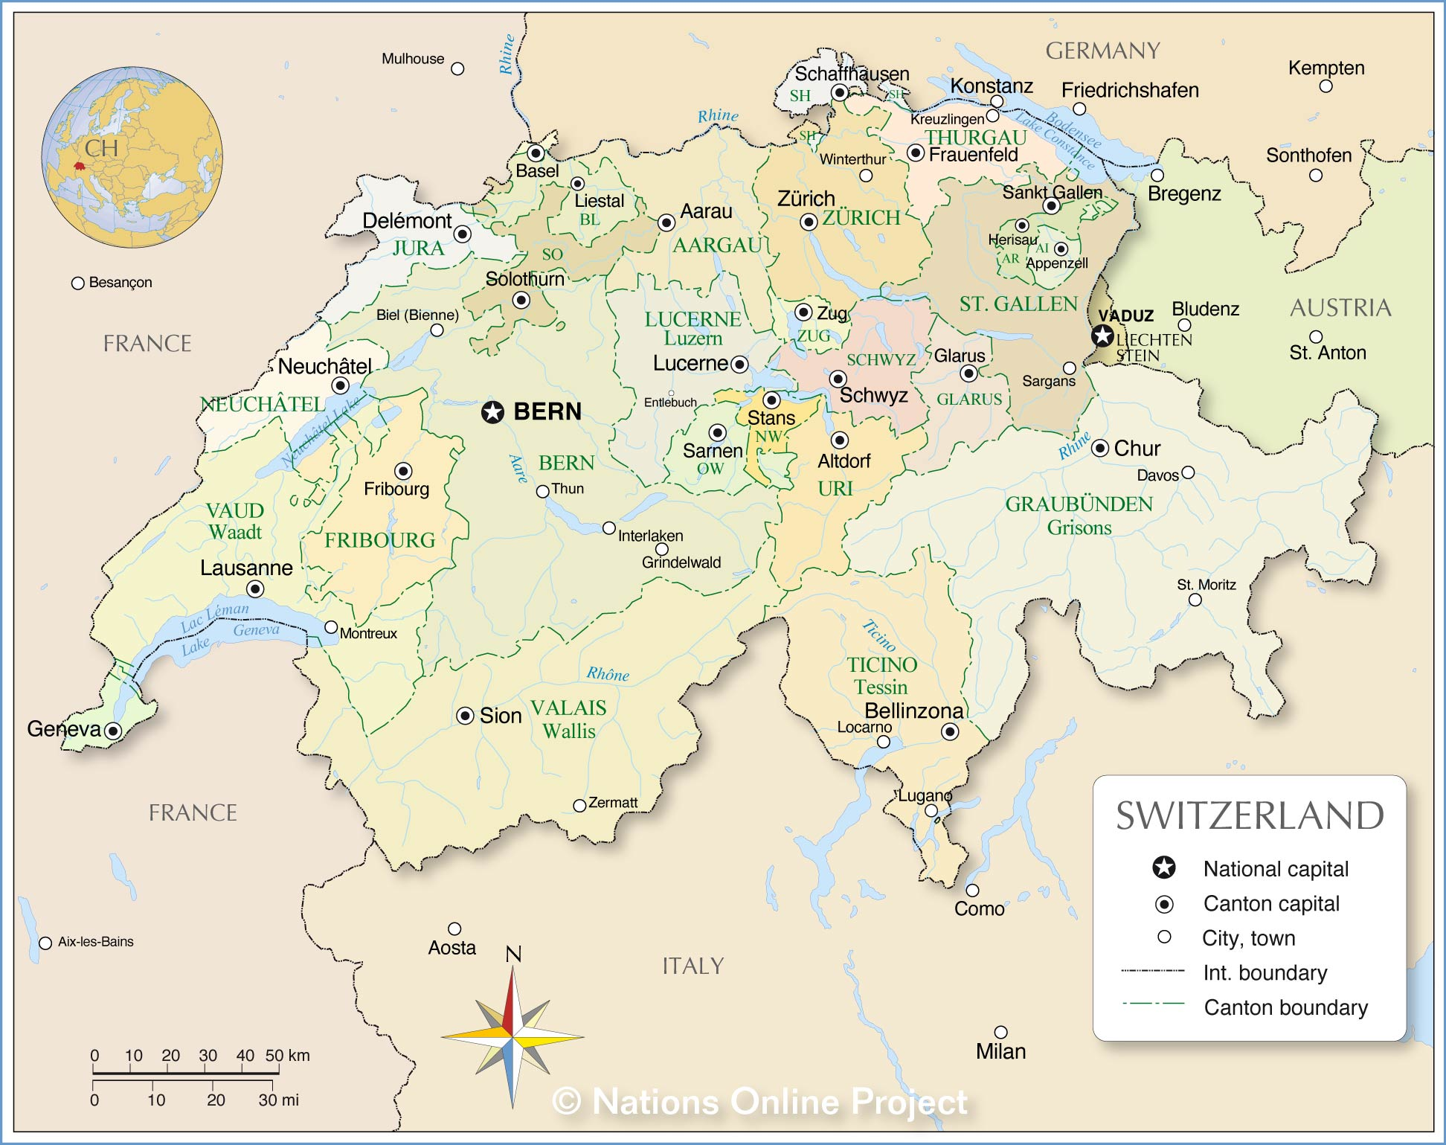
Psychiatric university hospitals with IPS programs
8.5 million inhabitants, 25 % non-swiss residents
26 cantons
4 languages

Slide 3
Overview of IPS in Switzerland I
Scale of IPS provision
IPS is primarily available at the psychiatric university hospitals in Bern, Lausanne and Zurich
Zurich: currently 10 SE specialists
Bern: currently 10 SE specialists
Lausanne: currently 12-15 SE specialists
Clients (in normal times)
Bern – About 80 clients per year
Zurich – About 100 clients per year
Lausanne – About 130 clients per year

Slide 4
Overview of IPS in Switzerland II
Health and welfare landscape
The university hospitals where IPS is offered are part of the regular mental health services in their regions.
There is no such thing as a level structure of mental health services in Switzerland.
IPS/SE is just one part of the employment arrangements that are available besides conventional occupational rehabilitation programs.
Most of the early key leaders in the Swiss IPS movement have been academics who are now retired.
IPS/SE is funded in general by the Swiss Invalidity Insurance that receives 1.4 % from each salary in the country.
The particular funding for individual cases is provide by the cantonal disability pension authorities. Conditions vary between cantons.
Funding

Slide 5
Development of IPS in Switzerland
IPS was introduced via research studies:
EQOLISE – Zurich 2003
IPS-SE study – Bern 2003
Lausanne followed in 2009 with a SE program that switched to IPS in 2012
Barriers and facilitators
Research has been the main facilitator for implementation
Conventional rehabilitation programs have a huge lobby in the country and compete with IPS programs for funding
There is no evidence-based process associated with funding decision-making
Main discrepancies to US IPS model
Invalidity insurance insists on pre-selection of clients
No regular evaluation on the basis of the fidelity scale

Slide 6
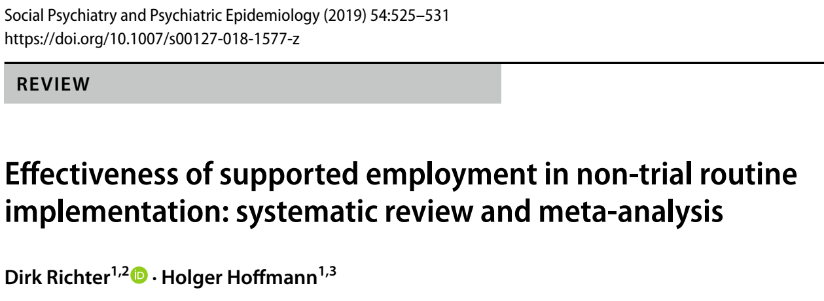
Evaluation of the Bern IPS program
Routine data evaluation 2005 to 2016
In-depth analysis of changes
Comparison with a meta-analysis of SE routine programs

Slide 7
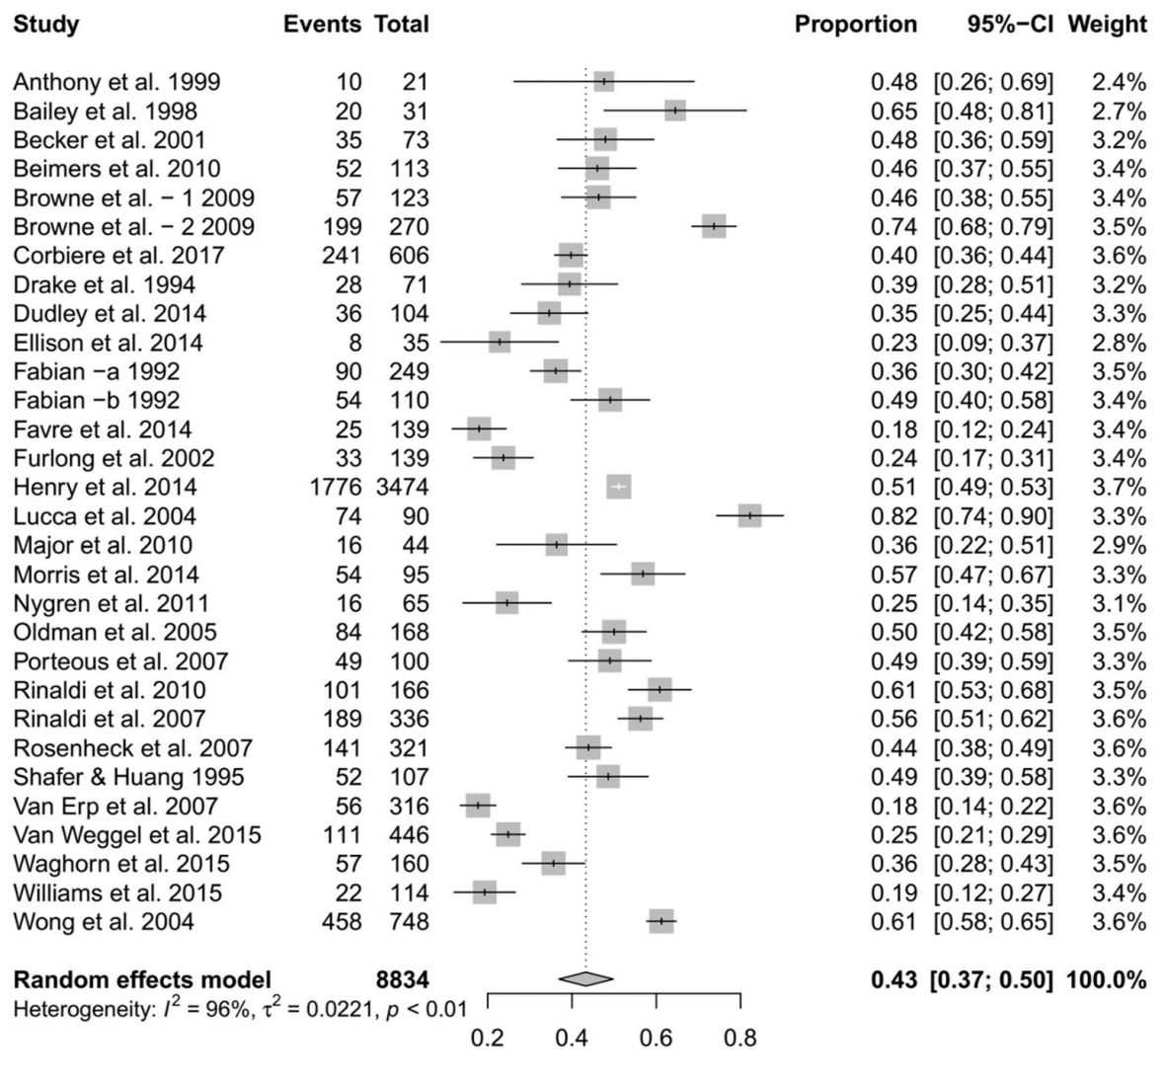
Meta-analysis of SE routine programs – Any competitive employment

Slide 8
Percentage of clients in competetive employment – Bern program
SE – Supported Employment – pooled data
PVT – Pre-vocational training – pooled data

Slide 9
Percentage of any competitive employment vs. permanent employment – ICD groups

Slide 10
Percentage of ICD-diagnosis per year (entries) – Bern program

Slide 11
Further IPS studies and activities in Zurich
ZhEPP
RCT
IPS for people with mental illness on social benefits
longitudinal study
several publications concerning job status, stigma
ZInEP
RCT
dose finding study;
several publications concerning length of placement time, quality of life, influencing factors
introduction of IPS in non-university hospitals in the Canton of Zurich

Slide 12
New cohorts and innovation
New cohorts
People who already receive disability pensions
Job retention
Supported Education – Start2Work program at Bern
Long Covid population
Innovation
Augmentation: digital skills training on the job

Slide 13
Recent publications
Rössler W et al.: 'Placement budgets' for supported employment: impact on employment rates in a multicentre randomised controlled trial. Br J Psychiatry 2020, 216(6):308-313.
Hoffmann, H./Richter, D.: Supported employment in Switzerland-Are we on track? Psychiatr Rehabil J 2020, 43(1):72-75
Rössler W et al.: Predictors of Employment for People With Mental Illness: Results of a Multicenter Randomized Trial on the Effectiveness of Placement Budgets for Supported Employment. Front Psychiatry 2019, 10:518.
Richter D./Hoffmann H.: Effectiveness of supported employment in non-trial routine implementation: systematic review and meta-analysis. Soc Psychiatry Psychiatr Epidemiol 2019, 54(5):525-531.
Richter D. et al: Supported Employment in Routine Operation: Evaluation of the Bern Job Coach Placement Program 2005 – 2016 (in German). Psychiatr Prax 2019, 46(6):338-341.

