Slide 1
Inaugural European IPS Meeting 16-18 Sep 2021
Peer support and co-production of IPS service development
Sweden
Ulrika Bejerholm, Suzanne Johanson, Ulrika Liljeholm
Lund University, Medical Faculty, Department of Health Sciences, Mental Health, Activity and Participation
Centre of Evidence-based Psychosocial Interventions (www.cepi.lu.se)

Slide 2
Introduction
Sweden

Slide 3
Overview of IPS in Sweden
Scale of IPS provision
Approximately 4 Mental Health Services Regions in Sweden
Approximately 35 IPS teams organised in Social Services
Commissioned educations at Lund University (350 employment specialists since 2012).
Regular and first episode psychosis outpatient teams
Employment specialist part of team (ACT or FACT)
IPS teams organised within Social Services with attempts to integrate MHS
Clubhouses employ employment specialists
Welfare regulations and benefits of Public Employment Service, Social Insurance Agency, and Social Services are not compatible with IPS
Health and welfare landscape
Funding
National incentives
National Board of Health and Welfare-project funding
National Financial Cooperation, FINSAM-project funding
Regional and local MHS and Social Services
An increase of attempts to make IPS a regular services, in stead of add-ons
Notes:
One for ES, an one for supervision and
who becomes integrated in the psychosis team or team for other service users with long term mental health problems

Slide 4
Development of IPS in Sweden
Through a randomized controlled trial (2008-2011), to benchmark Swedish vocational outcome in relation to the EQOLISE trial, 42% vs. 11%, (Bejerholm et al)
National Board of Health and Welfare publishes National Guidelines of Psychosocial Interventions and IPS (highest priority) for persons with schizophrenia and similar disorder or limitations (2011)
Commissioned education with national intake
National Board of Health and Welfare funds implementation of 32 Social Services to implement National Guidelines of IPS (2012-2014)
Development of IPS networks
Implementation research of 14 sites over 2 years
No real adaptions on a strategic level but a learning community that has grown. Critical to stay close to the original model although contextual factors impact (accept lower fidelity scores given national, regional and local circumstances).
Implementation research has helped to explain prerequisites and facilitate solutions

Slide 5
Approach to quality and innovation
Quality assurance
Innovation and future direction
Fidelity experts from the IPS networks have been identified and educated (commissioned education), and tries to help each other out
No external, national or regional, funding for fidelity reviews. It becomes part of the learning organisation and coproduction occurs on national, regional and local levels.
New staff are most likely sent to the IPS-education, where the exam is to collect data to prepare for IPS fidelity review locally
No national monitoring of outcomes, but local outcomes are collected in most context
Research on IPS
Persons with affective disorder
Newly psychosis teams
Integrated with Supported Education
Developed as web-based self-help application with the aim to empower the user in the return to work process (mWorks)
Future support still by:
Swedish National Board of Health and Welfare provides national guidelines
Swedish Bureau of Health Technology Assessment (SBU)
Swedish Association of Local Authorities and Regions (SKR)

Slide 6
Effectiveness of a web-based self-management application, mWorks
Strength-based and developed to empower service users during RTW process and at work
Co-produced with service users, RTW professionals, employers, gaming developers and researchers
Developed through formative research and is now tested in process evaluation and RCT

Slide 7
Peer support and co-production of service development
A workshop

Slide 8
Our learning objectives
1) Learn about critical components of implementing IPS
2) Recognize how peer support and coproduction may facilitate IPS in your community
3) Describe opportunities for developing coproduction with stakeholders in your own context

Slide 9
Critical implementation components

Slide 10
The National Guideline implementation project of IPS
To what extent could the IPS be "implemented" in practice?
Method- Selection
14 out of 32 businesses that receive financial support for the implementation of IPS
Method- Data collection
Interview-series with managers, users and staff
Fidelity reviews in coproduction
Documentation when having collaborative meetings
Method-Data analysis
Identify critical components for sustainable implementation *
Deductive analysis based on the components at 1 and 2 years
Program fidelity measurements at 1 and 2 years
*Sustainable Implementation Scale (SIS)
Notes:
The National Board of Health and Welfare commissioned us to study the implementation of Individual Placement and Support (IPS)

Slide 11
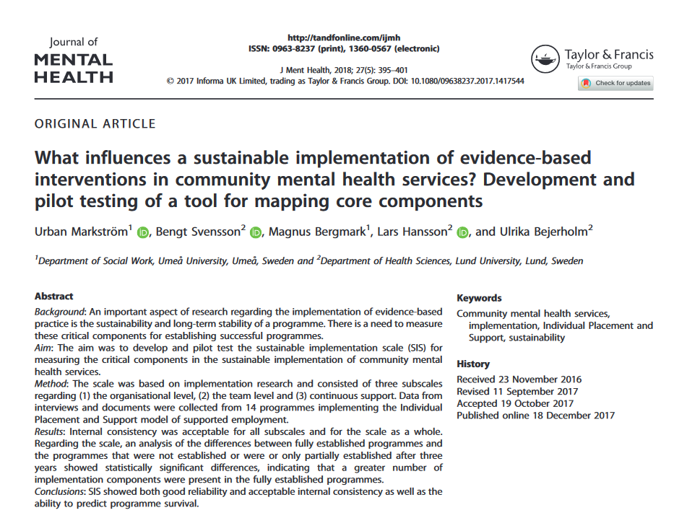
Sustainable Implementation Scale (SIS)

Slide 12
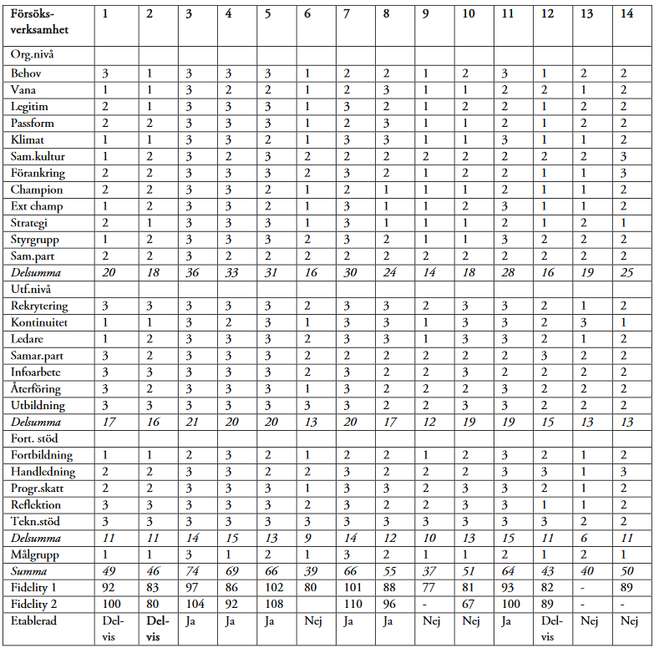
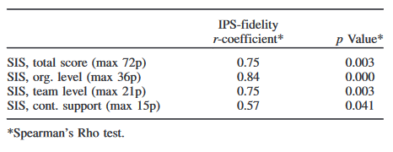
Analysis model
Sustainable Implementation Scale

Slide 13
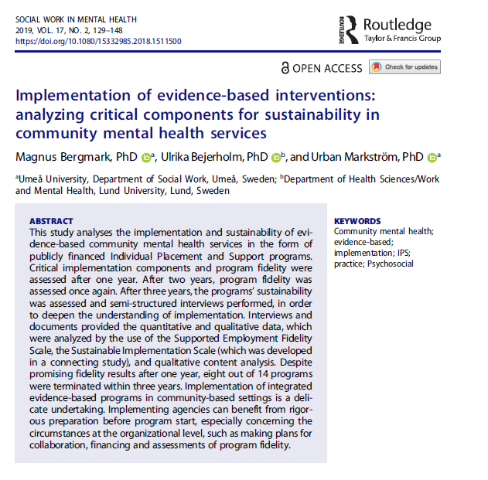
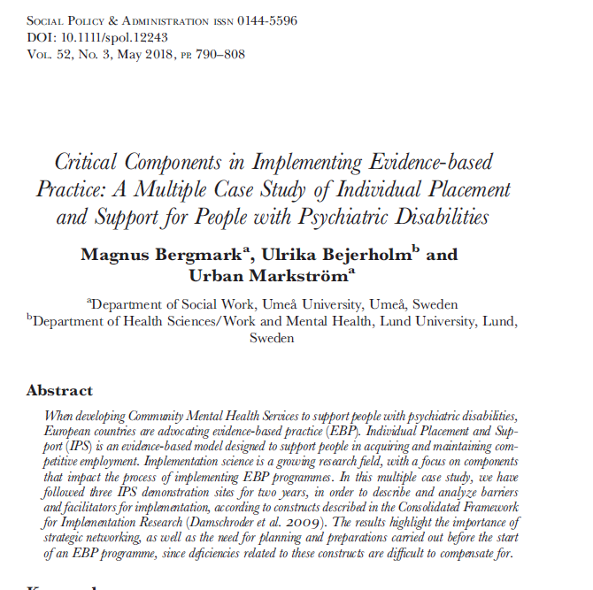
Further research from the national guideline project

Slide 14
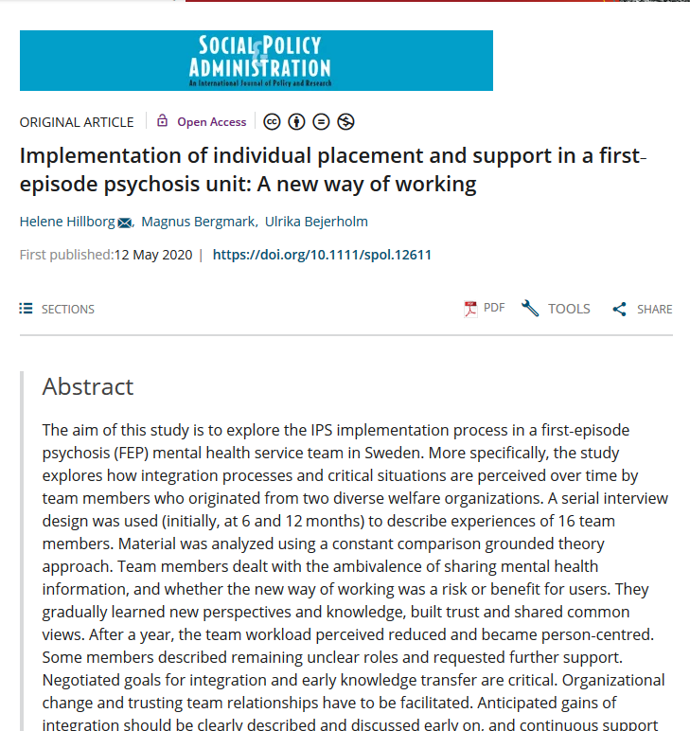
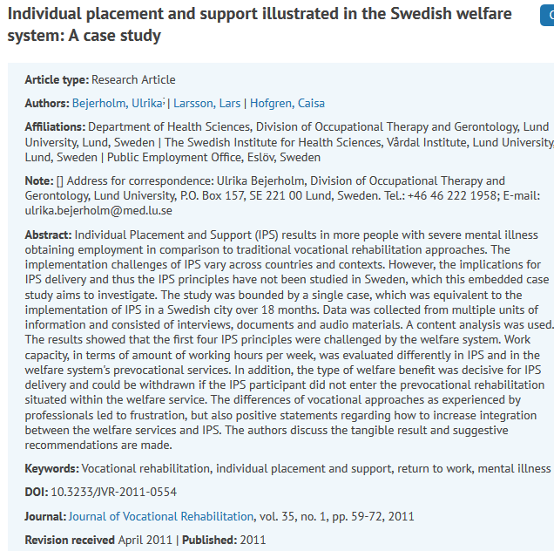
Further research on IPS implementation

Slide 15
Time to Talk
Reflect over your implementation situation?
What are the main barriers and facilitators on a organisational, team and continuous support level?
Notes:
Team level:
Selection of staff, recruitment
The social architecture of the business
Networks and contacts within the business
Staff group norms and values
Implementation climate in the team and the business attitude, priority, learning climate, preparedness, encouragement
Education and training of staff in connection with project start
Education and training of staff during implementation
Supervision of staff Work evaluation, staff evaluation and feedback
Facilitating administrative support
Organisational level:
Support in existing policy
Local perception of the users '(patients') needs
The main stakeholders' room for maneuver
Financing
Organizational structure and fit
Cultural and social capital (sitting in the walls)
Social and cultural experiences, collective memories, ways of acting, thinking and having contact with each other
The design of the management function
Access to key people / "purveyors" (managers, unit managers, contact persons)
Access to experts / "champions" (specialists in the development of SVP, R&D)
Vertical communication within the organization
Horizontal communication within the organization
Continuous support:
Quality reviews
Continuous dialogue and support
Facilities and equipment

Slide 16
Peer support and coproduction

Slide 17
Peer support
Peer support forms an essential part of recovery-oriented services (Slade et al, 2014; Bejerholm & Roe 2018)
Peers are people with lived experience of mental illness and who have dealt with it, and in a unique position to provide support and hope to others coping with similar challenges (Bejerholm & Roe 2018; Daniels et al, 2010; Deegan, 1988; Slade et al, 2014)
Support service users to become active participants in their recovery process, breaking out of the passive and isolating ‘mental patient’ role, and identify strengths and goals and combat stigma
Serve as role models for community integration as well as personal autonomy and self-worth
Work collaboratively with other team members and has a professional position as staff
Qualitative outcomes regard a sense of hope and control, as well as social inclusion and quality of life (Davidson et al, 2012; Sells et al, 2006)
Quantitative outcomes regard an increase of social integration and quality of life, and a decrease if re-hospitalization for frequently admitted service users (Chinman et al, 2014; Lloyd-Evans et al, 2014; Sledge et al, 2011)
Notes:
Slade M, Amering M, Farkas M, et al. Uses and abuses of recovery: implementing recovery-oriented practices in mental health systems. World Psychiatry 2014;13:12–20.
Bejerholm U, Roe D. Personal Recovery within Positive Psychiatry. Nordic Journal of Psychiatry, 2019; 72(6): 420-430.

Slide 18
Peer support
IPS provide opportunities for recovery (Areberg & Bejerholm, 2013; Bejerholm & Roe, 2018; Gammelgaard et al, 2017)
Work and student identity development (Liljeholm & Bejerholm, 2019; Liljeholm et al, submitted)
Career development process (Liljeholm & Bejerholm, 2019; Liljeholm et al, submitted)
Peers may enhance recovery-orientation in IPS, become employment specialists or leaders, and support quality of evaluations of IPS (Dartmouth Psychiatric Research Center, Lebanon, New Hampshire Psychiatric Services 2015; 66:337; doi: 10.1176/appi.ps.660402)
Identification with peers’ lived experience promote engagement and a sense of normalcy (Balogun-Mwangi et al, 2019)
Peer employment specialists have shown to support 33% of their caseload to competative employment (tenure 26 weeks) (Kern et al, 2013)
Notes:
In Sweden, peer groups were facilitated to create a meaningful social context where social roles of being a worker, student or job seeker could be supported, sharing experiences and skills were critical, already from the start in 2008. Peers also became lecturers in our commissioned education. And now, some peers, and employment specialists and me are planning the day-seminar. I would say that listening to peers who support each other and tell their stories in education is probably the strongest game changer for shifting care paradigm, from having an objective stance to learn how to listen and share views.
Balogun-Mwangi, O., Rogers, E. S., Maru, M., & Magee, C. (2019). Vocational peer support: Results of a qualitative study. The Journal of Behavioral Health Services & Research, 46(3), 450–463.
Kern, R. S., Zarate, R., Glynn, S. M., Turner, L. R., Smith, K. M., Mitchell, S. S., Becker, D. R., Drake, R. E., Kopelowicz, A., Tovey, W., & Liberman, R. P. (2013). A demonstration project involving peers as providers of evidence-based, supported employment services. Psychiatric Rehabilitation Journal, 36(2), 99–107. https://doi.org/10.1037/h0094987
key factor in the effectiveness of vocational peer support is the identification with another individual’s “lived experience,” which then promotes engagement and a sense of normalcy.
Peers as employment specialists demonstrated that 33% of their caseload gained competative jobs for approimately 26 weeks.
This career development process is called "vocational recovery." Mental health peers are increasingly playing an important role in this process. This toolkit describes how peer specialists are working to deliver and support IPS services.
They provide recovery-oriented pre-and post-employment services. They also deliver IPS directly as employment specialists and team leaders. They help preserve quality standards as members of IPS fidelity audits and training programs. Read further to learn more about how this is happening across the U.S.

Slide 19
Co-production
Regards transformation of control of power
New way of thinking about eachother (leaders, service users, professionals, carers)
Develop a shared understanding of change and what is needed
Co-production facilitate change
A shared vision and strategy
Lead by examples, tone and culture
Empower to work co-productively
(Duffy et al, 2018; King & Gillard, 2019)
Notes:
Our communication, tone and culture are critical for fascilitating implementation. To make this happen you need to set an example yourself of sharing power and understanding. To develop a culture that reflects the partnership that is build between the employment specialist and the user during in IPS delivery.
It is as critical to empower each other when we work together as it is to empower service users. When looking at it, the IPS-principles is really about coproduction. Initially, to learn and share decisions about service users’ working goals, interests and preferences, and what job opportunities best match. However, specialists also build relationships and represent the user in a personal way while talking to team members, professionals who work with benefit and economy situations, and perhaps the engagement with employers, which is very much about coproduction I would say.
The new thinking about
Duffy A, Quigley A, Healy B, Brogan C, Walsh F, Delaney G, et al. Co-production in practice guidance document 2018-2020. Supporting the implementation of a national framework for recovery in mental health 2018-2020.

Slide 20
IPS - A co-produced service?
Co-production elements of IPS- not a product manufactured by the MHS
IPS goals and planning is co-produced by service professionals and -users
IPS is an integrative support were professionals and carers work in partnership with each service user (MHS, employers, RTW agencies, social and benefit services)
Good IPS outcomes when
service users receive individual support
mutual dialogue between service professionals and user
shared understanding of resources and challenges
generate mutual acceptable goals and evaluation plans
Notes:
Partnership, reciprocal influence, relationship-centered care

Slide 21
IPS-tools for a co-produced service
Fidelity review and workshops on a regular basis generate co-production activities, given the rich dialogue with various stakeholders (service users, managers, welfare actors)
Assessment of critical components on organizational, team, and continuous support levels can further facilitate sustainable implementation in addition to the IPS-tradition of steering groups, work meetings and supervision
Notes:
IPS represents different ways that relationships between services and users are understood and developed. It does not happen instantly. Slowly, partnerships and communities are growing. Challenges are shared and problems become solved as they come.

Slide 22
Case Sweden - A co-production learning community, rather than an excellent research community
Experts on a national level regarding IPS
Develop research questions with practice and service users
Supervision of research students
Perform research mainly on grass root level
Translates manuals and fidelity reviews with researchers and professionals
Update national guidelines
Compiles knowledge overviews
Support co-financing among welfare actors to support initial implementation
Call for research grants
Research
Participatory approach
National government guidelines and support
IPS services/ networks, public
Commissioned education with national intake
Experts on a national level regarding IPS
Develop practice in MHS and social services
Employment specialists become researchers
Develop research questions
Participate in research
Perform external fidelity reviews
Fidelity review of practice is the exam
Learns about implementation challenges and coproduction solutions
Student learns from researchers, IPS professionals (including peers), welfare actors, employers
Notes:
British IPS experts handled training, supervision and fidelity reviews and implementation support every six months
Peer groups were facilitated to create a meaningful social context where social roles of being a worker, student or job seeker could be supported, sharing experiences and skills
Researchers, peers, professionals and employment specialists became champions
Commissioned education at Lund University, all as teachers
Champions setting up IPS organizations (teams) in various contexts
Supporting the development of IPS networks
Co-producing research
Helps to build knowledge national website at for National Board of Health and Welfare
Translates the IPS manual and fidelity documentation from the US

Slide 23
Co-production and service development in the city of Södertälje
The “Södertälje model” of integrated mental health and social care
IPS placed in regular social services, ca. 300 participants/year since 2011 (SEd 2014)
The perspective of entitlement
aid-assessed efforts in accordance with act cant be removed
Engage concerned actors and authorities
National Board of Health and Welfare national guidelines
fidelity scale from a management perspective, internally and with concerned actors, users and authorities
Co-production in research, since 2014
Notes:
Södertälje has a long record of providing integrated mental health and social care services including vocational services, with both the county council and municipality. IPS has been in the ordinary service since 2011 with about 300 service users every year. This innovative way of integrate welfare services stated an example for how to co-produce IPS in a Swedish context.
The service use the perspective of entitlement. IPS efforts are aid-assessed in accordance with the Social Services Act and the Act on Support and Service for Persons with Certain Disabilities. Not always an advantage but from the long-term perspective it has contribute to stability in the organisation, where the IPS efforts cannot prioritized away when it’s a legal right.
The national guidelines was a breakthrough to engage concerned actors and authorities. Here the detailed fidelity scale been used in a management perspective. A tool for internal request of funds, but also to direct involve collaboration partners, and everyone been anxious for the numbers to look good where they are involved.
Then the early connection to, and cooperation with research has been fruitful to stay updated and to motivate the service and efforts.

Slide 24
Co-production and service development in the city of Södertälje
A learning community
Internal supervision, individual and group competens
Participation in national networks
Education at university
Internal and external recruitment
the recovery perspective
Concerned actors and authorities
steering group
co-production meetings for staff
Employers
The dialogue with service user
peer-support groups
Notes:
Internal supervision highlights in the systematic work with development of competence, in group and individual level among the work specialists. Staff also are active in different national IPS networks, and all go for the commissioned education at the University, given important legitimacy.
In all recruitment, the thinking and interest of the recovery perspective are considered. Also important when recruiting contact persons from the other co-production partners. We have a joint steering group with the concerned actors and authorities. Here we convey the fidelity measurements and results, directly related to collaboration forms. We also have regular co-production meetings for staff bi-weekly. To explain conditions, provide opportunities and update each other on the different actor's service.
Important is the contact with the employers that contribute to increase the knowledge about mental health problems on the labour market and of course to create work opportunities for service users.
Of course the dialogue with the service user is the fundamental for designing the support and the service. Also arranging at least two peer-supports groups each semester.

Slide 25
Co-production and service development in the city of Södertälje
Future direction
Expand the IPS service for persons with addiction and high-functioning autism
authorities and providers in substance abuse care
IPS preventively for young adults aged 18-25 years
municipality's follow-up responsibility for young people not in education, employment or training
schools' student health
Social Insurance Agency
employment service
Notes:
Future perspectives in the service is the expand for persons with addiction, which the national guidelines since 2018 recommend, and for persons with high-functioning autism. This challenges the service to built up cooperation with new authorities and pick up the needs of the new groups.
Based on the increasing mental health problems among young adults, we have expand the service to work with IPS preventively. Young adults aged 18-25 years have direct entrance through their own registration. Many have difficulties, but its open for all, so they don't need to have contact with the mental health care or a diagnosis. Here we cooperate with the municipality's follow-up responsibility for young people, the schools' student health and so on. Since the start 2019 we had in total 140 participants with a high proportion for studies and work. So far 2021 43% started to work and 25% started to study.

Slide 26
Importance of co-production for young adults’ recovery and development of work identity
Organisation
Research results
Integrated MHS and vocational rehabilitation (social services) into one MHS unit for young adults in Södertälje
Co-location and sharing of workplaces
An interprofessional team including employment specialists
Person-centred support for service users to reach personal work and education goals
The partnership support in SE and SEd facilitated development of:
work identity important for the transition to adulthood, career development and future perspective (Liljeholm & Bejerholm, 2019)
student role entailing positive identity formation and reduction of stigma important for a personal recovery process (Liljeholm et al., sumitted)
increased quality of life, level of activity, and depression less severe after a year (Liljeholm et al., 2020)
Notes:
In the co-production of integrated MH services and vocational rehabilitation in one exclusive unite for young adults in Södertälje, we studied the service-users experiences.
The integrated service had co-location, shared workplaces and joint interprofessional teams, with work specialist in.
The result showed that no matter the work-related outcomes, the partnership support in IPS and SEd was an opportunity to develop work identity important for the transition to adulthood and future perspective in life. And facilitated the student role entailing positive identity formation and reduction of stigma important for a personal recovery process.
Further the longitudinal result showed that the mental health increased after one year. The young adults valued that quality of life and the level of activity in daily life increased. And rated their depression more difficult in the beginning compared to a year later.

Slide 27
Co-production and service development when integrating IPS in mental health services in the city of Stockholm
The financial coordination facilitates the IPS implementation in Stockholm and started in 2019 – a way to coordinate and collaborate between organizations and authorities
The project manager was educated and trained in IPS and IPS supervisory in the commissioned education – researchers follow the project and collaborate both with the steering group and with clinicians
Five mental health care units participate, 5 ES are employed by the municipality
Participants total:133, participating right now: 88, service users who have acquired employment: 15 and education: 11
Notes:
Södertälje has a long record of providing flexible and integrated mental health and social care services including IPS vocational services, with both county council and municipality. The service have been in the social cares ordinary service since 2011 (SEd 2014) and have ca. 300 service users every year. With this innovative way of integrating welfare services the Södertälje model stated an example for how to implement IPS in a Swedish context. 2019 the model reorganized into a more traditional service, however the IPS service is going on. From the beginning the service used the perspective of entitlement. It has given stability in the organisation with the IPS efforts aid-assessed in accordance with the Social Services Act and the Act on Support and Service for Persons with Certain Disabilities. Not always an advantage but from the long-term perspective it has contribute to stability. The IPS service cannot prioritized away when it’s a legal right.
The national guidelines was a breakthrough for the service. The guidelines motivate the importance of the efforts, engage all cooperation partners, and stress the importance to co-produce around the vocational service in the mental health care. Management has been competent in method. Conscious give strong support for the service, crucial for the development and success to continue through the years. The detailed fidelity scale has been a tool in a management perspective. Of course for the internal development and request of funds, but also in the contact with collaboration partners. Its been a direct way to involve partners, and everyone has been anxious for the numbers to look good where they are involved. The early connection and engagement in research in cooperation with Lund and Umeå University, has been fruitful to stay updated, and critical to motivate why we need to invest in IPS and this co-production.

Slide 28
Mutual collaboration on organizational and team level
Municipality
Social Insurance Agency
Public Emploment Service
Mental Health Service
Peer support organizations
Service users
Financial coordination
FINSAM
Members of
co-production
Employers
Employment specialists
Research

Slide 29
Implementation factors of IPS according to some of the items in the SiS framework – a co-production perspective
Organizational level
Legitimacy in the various organizations
Mental health services positive but still lack some knowledge of IPS
To start with, the Public Employment Service wanted the participants to engage in stepwise vocational services that they provide
Implementation climate
Four of the five mental health units prioritize integration of IPS
The model’s organizational fit
Great efforts in adapting to rules of PES, rather than finding collaborative solutions
Organizational collaboration
Steering group level; great efforts to find pathways in the social insurance system – meanwhile there are hindrances for collaboration at the team level (employment specialists and case workers at Social Insurance Agency)
An implementation group was organized early in the process
Team level
Several units have team members supporting the IPS
In some units case managers are keen to decide who suits to participate in IPS (opposite to zero exclusion)
Several managers have quit their position
From start there was small opportunities for ES:s to communicate IPS in the team consultations, this has changed over time
There is one unit where there is little interest in integrating IPS, several ES have discontinued their job
Continuos strategies for support
There is on-going supervision and support for ES and managers in the mental health units
There is a need for IPS education and training for team members
Programme fidelity is assessed every 6th month

Slide 30
Time to Talk
Can ”peer support” benefit your IPS service?
How may co-production facilitate IPS in your community?
Notes:
Preparation – Before Co-Production Occurs YES NO
Is there any conflict between facilitators/stakeholders or is there anything
that may prevent effective co-production from occurring?
(All Co-Production Activities)
Have facilitators/stakeholders enough time to properly prepare for the
co-production activity? (All Co-Production Activities)
Is professional hierarchy evident between facilitators/stakeholders?
(All Co-Production Activities)
Are facilitators/stakeholders willing to work together equally?
(All Co-Production Activities)
Are facilitators/stakeholders willing to accept new recovery ideas and roles e.g.
Peer Support Workers/Peer Educators/Recovery Colleges and their importance
in co-production? (All Co-Production Activities)
Can this co-produced activity occur in a mutually accessible location e.g. rural
communities etc? (All Co-Production Activities)
Have service provider facilitators/stakeholders been given support by their
line managers/supervisors etc to partake in the co-production activity?
(All Co-Production Activities)
Have facilitators/stakeholders received adequate training in facilitation and
co-production? (All Co-Production Activities)
Have facilitors/stakeholders developed a plan on how they will co-produce?
(All Co-Production Activities)

Slide 31
Publications 2021-2018:
Liljeholm U. Hillborg H, Löfgren V, Rosenberg D, Bejerholm U. The journey to my student identity: A grounded theory study on supported education for young adults with mental health problems. Accepted for publication.
Engdahl P, Svedberg P, Bejerholm U. Acceptability of a digital return-to-work intervention for common mental disorders: a qualitative study on service user perspectives. BMC Psychiatry. In press.
Wallstroem IG, Pedersen P, Christensen TN, Hellström L, Bojesen AB, Stenager E, White S, Mueser KT, Bejerholm U, van Busschbach JT, Michon H, Eplov LF. A Systematic Review of Individual Placement and Support, Employment, and Personal and Clinical Recovery. Psychiatric Services, 2021 May 4:appips202000070. doi: 10.1176/appi.ps.202000070
Hellström L, Pedersen P, Nordahl Christensen T, Gammelgaard Wallstroem I, Bojesen AB, Stenager E, Bejerholm U, van Busschbach J, Michon H, Mueser KT, Reme SE, White S, Falgaard Eplov L. Vocational outcomes of the individual placement and support model in subgroups of diagnoses, substance abuse, and forensic conditions: a systematic review and analysis of pooled original data. Journal of Occupational Rehabilitation. 2021 Mar 4. doi: 10.1007/s10926-021-09960-z.
Lexén A, Emmelin M, Hansson L, Svensson B, Porter S, Bejerholm U. Changes in rehabilitation actors' mental health literacy and support to employers. Work. 2021;69(3):1053-1061. doi: 10.3233/WOR-213535
Hillborg H, Lövgren V, Bejerholm U, Rosenberg D. Integrating interventions that can support a career-oriented recovery for young adults: Building on the supported education knowledge base. Journal of Psychosocial Rehabilitation and Mental Health. 2020; 8(1):35-60. doi: 10.1007/s40737-020-00197-2
Engdahl P, Svedberg P, Lexén A, Bejerholm U. The role of a digital return-to-work solution for individuals with common mental disorders: perspectives of three stakeholder groups. Journal of Medical Internet Research (JMIR) Formative research, 2020;4(9): e15625. doi:10.2196/15625
Hillborg H, Bergmark U, Bejerholm U. Implementation of Individual Placement and Support in first-episode psychosis unit: A new way of working. Social Policy and Administration. 2020. doi: 10.1111/spol.12611
Lövgren V, Hillborg H, Bejerholm U, Rosenberg D. Supported Education in a Swedish Context? Opportunities and Challenges for Developing Career-oriented Supports for Young Adults with Mental Health Problems. Scandinavian Journal of Disability Research, 2020; 22(1):1-11. doi: 10.16993/sjdr.648
Johanson S, Markström U, Larsson ME, Bejerholm U. Implementation of a novel-return-to-work approach for persons with affective disorders in a traditional vocational rehabilitation context: a case study. International Journal of Mental Health System. 2020;14:22. doi: 10.1186/s13033-020-00355-w. eCollection 2020.
Porter S, Lexén A, Bejerholm U. Employers’ beliefs, knowledge and strategies used in providing support to employees with mental health problems. Journal of Vocational Rehabilitation, 2019; 51(3): 325-337. doi:10.3233/JVR-191049
Lexén A, Emmelin M, Hansson L, Bejerholm U. Exploring the service and knowledge gap between rehabilitation professionals and employers in the return-to-work process of people with mental health problems in Sweden. Work. 2019; 64(3):495-506. doi: 10.3233/WOR-193011
Notes:
From RCTs to self-managment applications. Since 2011 we have performed two trials and four trial studies, some correlational studies, and qualitative studies. 5 dissertations and one on-going. In all 38 original publications.

Slide 32
Publications 2018-2021
Liljeholm U, Bejerholm U. Work identity development in young adults with mental health problems. Scandinavian Journal of Occupational Therapy. 2019 Jul 12:1-10. doi: 10.1080/11038128.2019.1609084.
Johanson S, Markström U, Bejerholm U. Enabling the return-to-work process among people with affective disorders -A multiple case study. Scandinavian Journal of Occupational Therapy. 2019; 26(3):205-2018. doi: 10.1080/11038128.2017.1396356.
Porter S, Lexén A, Bejerholm U. Mental health literacy among vocational rehabilitation professionals and their perception of employers in the return-to-work process. Vocational Rehabilitation Journal, 2019; 50(2):157-169..
Bergmark M, Bejerholm U, Markström U. Implementation of evidence-based interventions: Analyzing critical components for sustainability in community mental health services. Social Work in Mental Health, 2019; 17(2):129-148.
Bejerholm U, Roe D. Personal Recovery within Positive Psychiatry. Nordic Journal of Psychiatry, 2019; 72(6): 420-430. doi: 10.1080/08039488.2018.1492015
Bergmark M, Bejerholm U, Svensson B, Markström U. Complex interventions and inter-organizational relationships: Examining core implementation components of Assertive Community Treatment. International Journal of Integrated Care, 2018; 18(4):11. doi 10.5334/ijic.3547.
Porter S, Lexén A, Johanson S, Bejerholm U. Critical factors for the return-to-work process among people with affective disorders: voices from two approaches. Work, 2018; 60(2):221-234. doi: 10.3233/WOR-182737
Porter S, Bejerholm U. The effect of Individual Enabling and Support on empowerment and depression severity in persons with affective disorders: outcome of a randomized controlled trial. Nordic Journal of Psychiatry, 2018; 72(4):259-267. doi: 10.1080/08039488.2018.1432685
Bergmark M, Bejerholm U, Markström, U. Critical Components in Implementing Evidence Based Practice - A Multiple Case Study of Individual Placement and Support for People with Psychiatric Disabilities. Social Policy and Administration, 2018; 52(3):790-808. doi: 10.1111/spol.12243.
Saha S, Bejerholm U, Gerdtham, U-G, Jarl J. Cost-effectiveness of supported employment adapted for people with affective disorders. Nordic Journal of Psychiatry, 2018; 72(3):236-239. doi: 10.1080/08039488.2017.1422801.
Markström U, Svensson B, Bergmark M, Hansson L, Bejerholm, U. What influences a sustainable implementation of evidence-based interventions in community mental health services? Development and pilot testing of a tool for mapping core components. Journal of Mental Health, 27(5):395-401. 2018. doi: 10.1080/09638237.2017.1417544.
Lexén A, Bejerholm U. Occupational engagement and cognitive functioning among persons with schizophrenia: an explorative study. Scandinavian Journal of Occupational Therapy, 2018; 25(3):172-179. doi: 10.1080/11038128.2017.1290135

Slide 33
Thank you!
Ulrika, Suzanne, Ulrika
ulrika.bejerholm@med.lu.se
ulrika.bejerholm@skane.se
suzanne.johanson@med.lu.se
ulrika.liljeholm@med.lu.se
ulrika.liljeholm@sodertalje.se
www.cepi.lu.se

