Slide 1
Implementing IPS within Drug and Alcohol settings: from policy to practice
Adam Swersky, Director Social Finance
Lynne Miller, National IPS Lead, IPS Grow

Slide 2
Plan for the session
Presentation to share learnings from England (20 mins)
Discussion at tables / on the floor (10 mins)
Open Q&A and discussion (20 mins)

Slide 3
Introduction
Introduction to Social Finance / IPS Grow
National Policy Agenda for IPS in Drug and Alcohol teams
Learning from early pilots, W London commissioned services and IPS in Drug and Alcohol RCT

Slide 4
Social Finance has helped to develop IPS for the past 8 years through our Health & Employment team
A
Secondary mental health care
Mental Health and Employment Partnership (MHEP) Social Impact Bond
IPS Grow
European IPS community; fidelity reviews in Ireland
GMCA Working Well – Specialist Employment Service
B
Primary care
The Link. Work & Health Unit Challenge Fund project integrating return-to-work advisers in GP surgeries in Leicester and Newcastle.
West Midlands Thrive Into Work (Health-led Trial)
C
Other health and care settings
MHEP expansion for people with drug & alcohol addictions and learning disabilities.
Public Health England IPS-AD trial fidelity reviews
Ireland – review of contracted employment programmes (with IES)
Vocational rehabilitation and trauma care
D
At work
Older workers quality of life – partnership with foundations

Slide 5
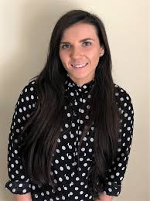
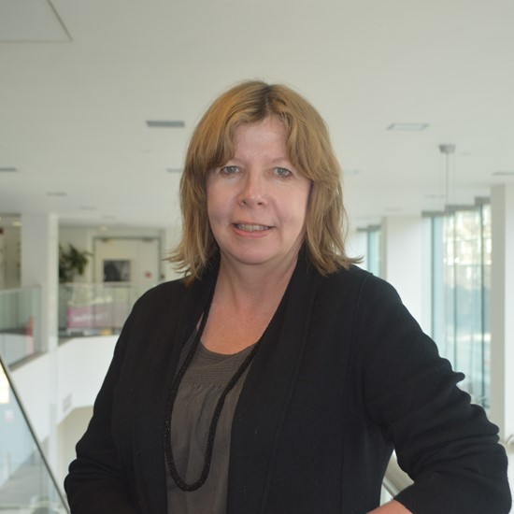
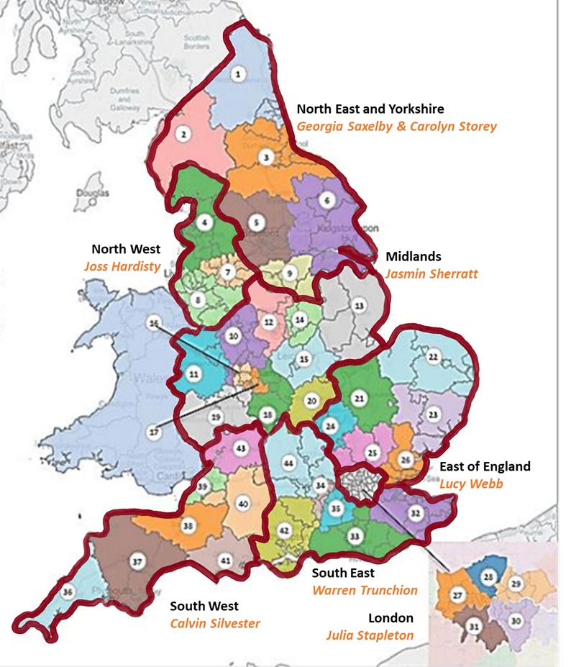
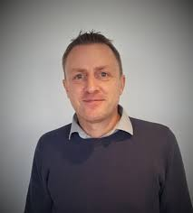
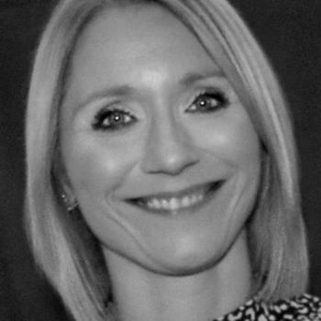
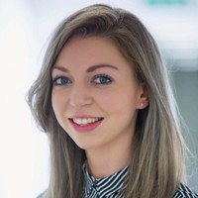
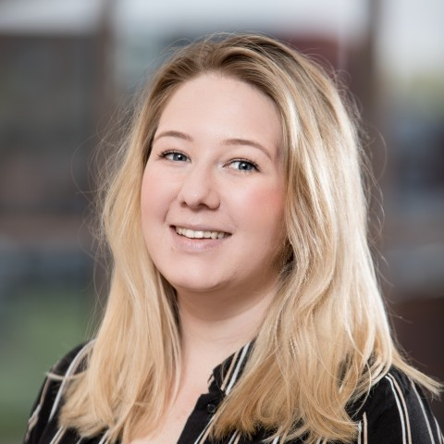
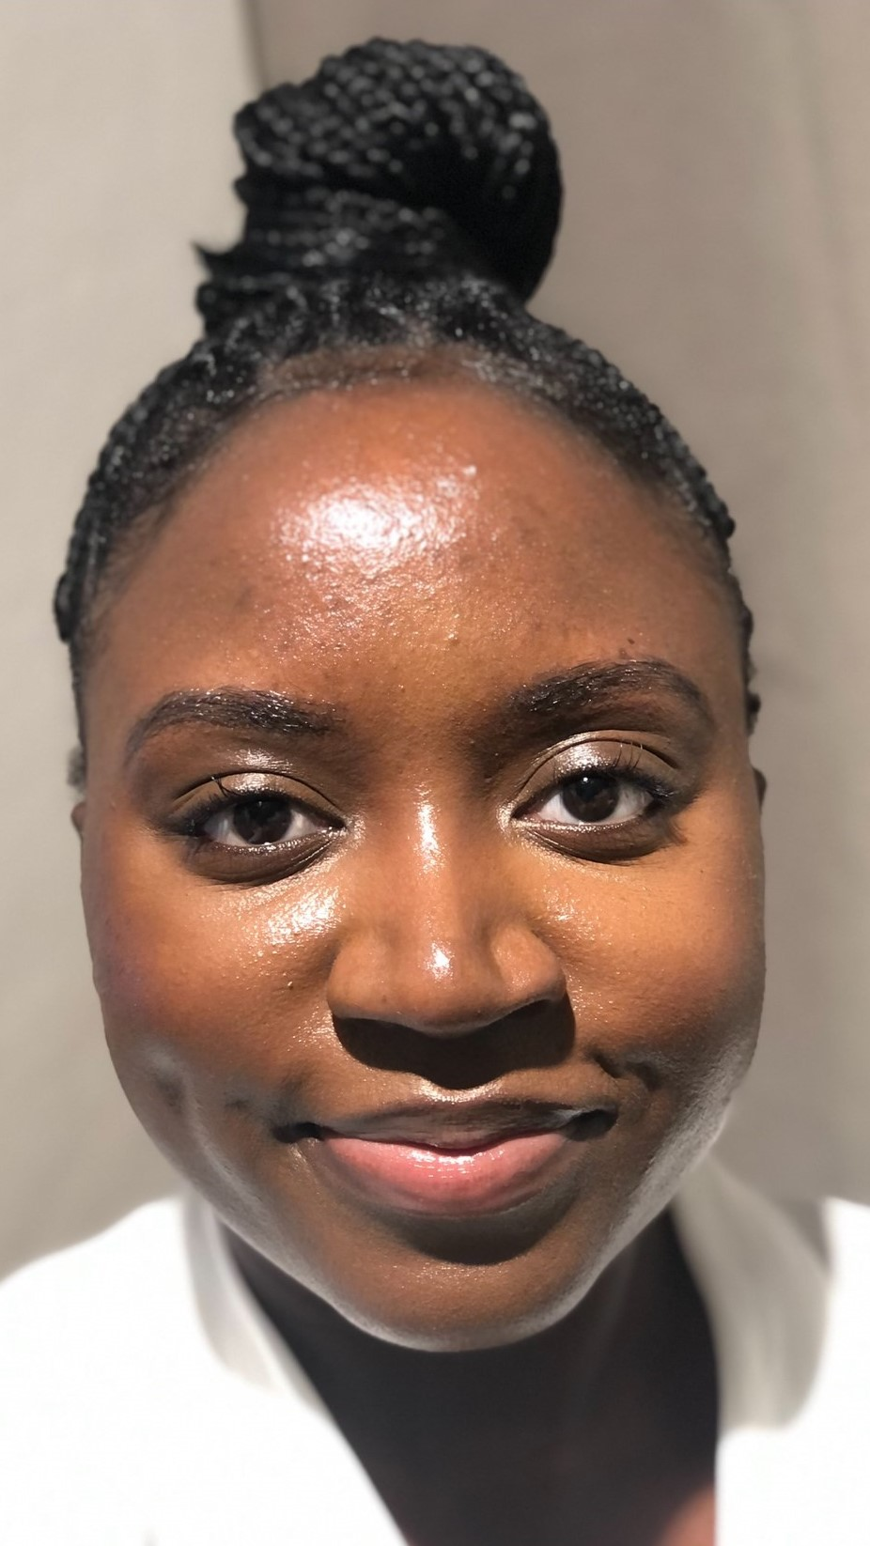
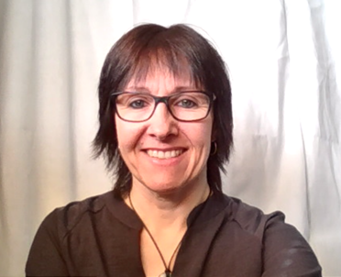
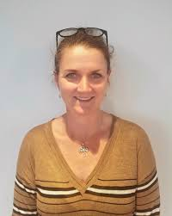
7 REGIONS, 42 STPS, 135 CCGS & 70 IPS PROVIDERS
National Lead
Lynne Miller
Carolyn Storey
IPS Grow team lead
Adele Marshall
Recruitment &
Marketing Lead
Martina Gibbons
Joanne Barber
“Doesn’t matter where you are in your journey, IPS Grow works with you where you are, you don’t feel judged, you feel able to be open about your support needs.”
Marketing & Communications
Assistant
Gloria Nalumansi
Calvin Silvester
Jan Hadfield

Slide 6
UK employment context in drug & alcohol teams
Employment gap is substantial, and little change over time – c. 8% of those in structured treatment move into work, c. 70% of people in treatment are unemployed throughout treatment
Increasing movement from treatment into employment prioritised by successive governments, but little ground gained
Good evidence for mutually beneficial relationship between treatment outcomes and employment

Slide 7
Similar picture for employment rates internationally

Slide 8
Development of IPS in drug & alcohol teams in England (1)
Local projects in London
National multi-site RCT
(2018-2020)
Major government report by Dame Carol Black (2016)
Expansion to 30+ sites
(late 2021-)

Slide 9
Development of IPS in drug & alcohol teams in England (2) – multi-site RCT
The first, large-scale RCT of IPS in the alcohol and drug treatment sector anywhere
Largest trial in English substance misuse field, one of the largest IPS trials internationally
Effectiveness, cost-effectiveness and cost benefit
May 2018 – Sept 2020
Three groups: opioids, alcohol only and other drugs
Two arm trial: IPS and TAU vs TAU only
Up to 9 months pre-employment support plus up to 4 months in-work support
Outcomes measured at 18 months from enrolment
Primary outcome: at least 1 day of employment in the open competitive job market during 18 month follow-up (standard for IPS trials)
Formal results pending – but positive indications. Roll-out to 30+ sites under way

Slide 10
DRUG AND ALCOHOL TREATMENT TEAM CULTURE
Challenges
Focus on “keeping people alive” and multi-agency model
High levels of stigma
Often clients have multiple health issues
Key workers sometimes have limited face to face contact with clients
Low expectations

Slide 11
DRIVERS OF CHANGE
Drivers of change
Preparation and on boarding – Treatment and agency Leadership teams
Bite size communication and learning
Treatment team champion and supervision for ES
Employment conversations
Right story telling at the right time – winning people over

Slide 12
CREATING AN MDT APPROACH
Giving examples – of MDT interventions
Ask me about work badges
Training and messaging on benefits of the approach for team and clients
Managing over-all health issues/relapse prevention
Treatment modified when job starts

Slide 13
SUPPORTING THE RESILIANCE OF THE IPS TEAM
Clinical team employment supervision and back up is vital
Helping IPS teams work very holistically – being aware of complex lives, health and fluctuating motivations of the client group
Assertive engagement – and managing potential emergencies
IPS Learning networks for IPS staff and commissioners

Slide 14
CLIENT ENGAGEMENT
Treatment team promotion, joint meetings/ wider family support
Hope - Clients often isolated and value having ES on their side
Recovery stories/recovery hubs/name badges
Meeting away from treatment teams
Assertive engagement/ client contracts
Diaries / texts / appt cards

Slide 15
IPS Practice
Discussing drug and alcohol history with employers – challenging for many clients, and not covered under the Equality Act
Staff and client training key – normalising the process and enabling client to drive the process – when, how what – over time. Letters personal statements (including criminal record)
MDT support – relapse prevention strategies when in work, building treatment around the job, not taking substances night before or day of work, managing money etc

Slide 16
Working with employers
FACE TO FACE EMPLOYER ENGAGEMENT IS CRITICAL
Needed to best match client to a job, as often feel sense of shame about past
CLIENT STRENGHTS
Emphasising the commitment and loyalty of clients and that employer will already have people in the workplace who have the same challenges
EMPLOYER STATEMENTS
Sharing positive feedback from employers / clients
IN WORK SUPPORT
Emphasising the commitment and loyalty of clients and that employer will already have people in the workplace who have the same challenges

Slide 17
Next steps
UK Trial results to be released in 2022
RCTs being planned in the USA
Discussions around pooling learning and resources from UK and USA

Slide 18
Table top / floor discussion
Discuss & agree with others 1 - 2 questions to ask us / the group
Discuss what the position is with IPS and D&A in your country
Discuss what challenges and opportunities you face to grow and develop high-quality services
Is there any learning you would like to add around some of the specific challenges in working with people in recovery from drug and alcohol abuse, and working with treatment teams.

