Slide 1
Valuing and Using Personal Experience in IPS Practice
Rachel E. Perkins BA, MPhil (Clinical Psychology), PhD OBE
Member of IPS Grow Expert Forum
Chair, IPS London
Co-editor Mental Health and Social Inclusion
Chair, Disability Advisory Committee of the UK Equality and Human Rights Commission

Slide 2
Within IPS services, frequently the primary focus is on professional IPS training, experience and skills of practitioners – these are important
BUT
all IPS practitioners bring more than this to their work
Experience of life (culture, beliefs, background, skills, talents, community knowledge and contacts, experience of different kinds of employment)
Experience of struggles and difficulties in life that have had an impact on their employment (mental health challenges, physical health challenges, challenging personal circumstances, problems at work)

Slide 3
All of these can be very valuable in mental health work in general and IPS practice in particular …
Appropriate sharing of personal experience “can foster a trusting relationship between service user and practitioner through similarity, credibility and shared understanding.” (Dunlop et al 2021)
BUT too often, in the UK, organisational cultures discourage practitioners from sharing personal experience
Perceived as violating professional boundaries and codes of conduct
Might result in disciplinary action
(Lovell et al, 2020; Dunlop et al, 2021)
Perceived ‘rules’ relating to sharing personal information are often unwritten …
across 20 main codes of practice, standards and ethics for mental health professionals the sharing of personal information is not forbidden
(Lovell et al, 2020; Dunlop et al, 2021)

Slide 4
What is the situation in your country about sharing personal information and experience in
mental health work generally?
IPS practice?

Slide 5
Increasingly the value of lived experience of mental health challenges is being recognised
Recognition of the value of lived experience of mental health challenges is not new:
In 18th century France at Bicetre Hospital, Pinel recommended that ‘recovered and convalescing patients’ be employed because, they were better able to understand and respond sensitively to patients
Since then there have been times when we in the UK have lost sight of this wisdom e.g. in 1994 UK Department of Health considered the employment of people with mental health challenges d a potential danger to patients … so anyone with such problems kept very quiet about them
Now mental health services in the UK are actively recruiting people with lived experience of mental health challenges in newly created ‘Peer Support Worker’ positions … and the value of such roles is widely recognised (e.g. Repper et al, 2013; Watson & Meddings, 2019)
… and in some IPS services ‘Peer Employment Specialist’ positions have been created

Slide 6
BUT
People employed in designated ‘peer’ positions’ are not the only people with lived experience of mental health challenges and employment
These roles are important in breaking down barriers and challenging stigma, but if we only employ people with lived experience of mental health challenges in designated ‘peer’ roles we risk:
Reinforcing the ‘them and us’ barriers that remain in mental health services
Failing to value and make use of the lived experience of other practitioners who have such lived experience
Our personal experience that may be of value is not restricted to experience of mental health challenges …

Slide 7
Every IPS practitioner has ‘personal experience’ that can be valuable in IPS practice, for example:
Personal history (e.g. age, marital status, sexual orientation, education, employment history)
Knowledge of different cultures and communities
Interests, preferences, hobbies, thoughts, feelings, views
Experience of mental health challenges and other struggles and difficulties in life that have impacted their work (e.g. raising children, physical health problems, divorce, death of someone)
Experience of friends or relatives who have experienced struggles and difficulties in life and work
Experience of struggles and difficulties in relation to work (e.g. coping with a difficult boss, being turned down for a job, being sacked or made redundant, returning to work after a period of absence)
Some examples given by IPS practitioners …

Slide 8
Some practitioners have made use personal life experiences
“In Blackpool we welcomed a lot of skilled Spanish nationals and their families ... I studied Spanish at university and have lived and worked in Spain, thus have experience of trying (and succeeding!) to find work in a foreign country. … I feel my lived experience (and language skills) meant that I was able to provide a better quality of Employment Support due to recognising the specific challenges the clients faced, and empathising with their emotional state.”
Senior Employment Specialist
“As a working mother of two children I have shared my personal experience with clients. Discussing the impact maternity had on me. Feelings of isolation, losing a sense of identity, I was very anxious about returning to work, worried that I had lost my social skills. Having spent over a year at home, often alone with my baby, I was worried that I wouldn’t manage both work and motherhood.
Employment Specialist
.
“Seeing the difference having a job made to my dad’s mental health and wellbeing, providing for his family was so important to his sense of self-worth, and I know that work didn’t just keep him well, it kept him alive.”
IPS Grow Lead
“I have worked with clients of the same ethnicity and I have been able to share knowledge with them about foods and herbs, commonly known to us.”
Employment Specialist

Slide 9
Some practitioners have made use of personal experiences of employment
“I often share with clients the challenges I’ve faced at different times in my career which may be similar to the challenges they are experiencing. Discussing these difficulties and sharing how they made me feel at the time can really help normalise the feelings of disappointment, regret, helplessness, loneliness, confusion, anger, fear etc. that we all experience at some point during our working lives. Surely this is a healthy thing to do?”
IPS Grow Regional Lead
.
“Setbacks, rejections and disappointments are part of everyone's life. …
Unfortunately, I have had my own share of unsuccessful job interviews. I learnt from my disappointments, I learnt from my mistakes, and I learnt from how I dealt with these and learnt from not dealing with these.
These are lived experiences, I use to help anyone.”
Advanced Lived Experience Employment Specialist
“Talking about how I have used personal networks and the hidden labour market during my career to get jobs.”
“Talking about how none of us get every job, to help people deal with not getting the job they want”.
IPS Grow Lead

Slide 10
Some practitioners have made use of their personal experience of mental health challenges
“I have only ever had positive feedback from sharing my experience with clients … When we explore the pros and cons of disclosure, I know first-hand what it is like to actually face stigma and discrimination (direct and indirect) in life and at times in work. However, I do not share specific details, often just an overview ‘I’ve had my own mental health struggles’.”
Employment Specialist
.
“I have used my personal experience of anxiety and PTSD when supporting people in similar situations. Ways of using distraction techniques particularly when approaching an activity like an interview, that they have not done for a period of time.”
Employment Specialist
“I have at times shared some of my own experiences, understanding and perspectives with people who have the same diagnosis as me … especially when choosing hours to manage work-life balance, and, in in-work support … staying well at work, as I have my own plans.”
Employment Specialist

Slide 11
Personal experience can be valuable in all facets of IPS practice
In work with individual clients
Promote authentic human-to-human interactions that foster a trusting relationship and feelings of equality
Foster hope and build a person’s self-esteem
Normalise experiences
Challenge myths and misconceptions
Show similarities and provide reassurance and offer alternative ways of approaching challenges
In employer engagement
“I find a good way to break down barriers with prospective employers is to talk to them about my own lived experiences. I do not go into detail, but will tell them I am also a service user and explain how being in work is not only good for my well-being but how having a weekly routine and feeling a valued team member has helped to keep me in recovery for many years. I think it is important that new employers can see a positive role model.”
IPS Team Leader

Slide 12
Within the IPS Team
Increasing the range of expertise available to all team members
Creating an environment where people can talk about challenges they face thus enhancing well-being and effectiveness
“When new members join my teams, very early on I talk about my own history of mental ill-health and experience of using mental health services… This has created a culture in our IPS teams where it is OK to speak out about challenges you are facing and accept vulnerabilities as a constructive and powerful tool. “
IPS Service Leader
In work with clinical teams
“I share the fact that, at a young age, I was once told by clinicians that I would never work again and how I overcame my challenges, returned to work and have built a career. It has led to a challenging of stereotypes and beliefs about what it is possible for the people who use our service to achieve.”
IPS Service Leader
.

Slide 13
While the appropriate sharing of personal experience is undoubtedly valuable … there can be risks attached to inappropriate sharing
For example
Removing the focus from the client
Burdening them with too much information
Creating confusion over the nature of the relationship
Giving personal contact information to the client
Invoking envy
Sharing personal experience for the practitioner’s benefit not the client’s (e.g. wanting to be liked, feel competent…)
Asking the client to keep secrets
Creating difficulties for the practitioner if they share experience that they are not ready to share or opening up subjects they are not comfortable discussing
(Henretty & Levitt, 2010; Audet & Everall, 2010; Ruddle & Dilks, 2015; Dunlop, 2021)

Slide 14
Guidelines for practitioners in the appropriate sharing of personal information
“Everyone is doing it but no one is talking about it. It is time we started.”
Ruddle and Dilks, 2015
The training of Peer Support Workers addresses the appropriate sharing of information about lived experience of mental health challenges
A number of guidelines have been developed relating to mental health practitioners sharing their lived experience of mental health challenges (for example, Scior, 2017; Meddings, Morgan & Roberts, 2019)
There are guidelines about professional/client relationships more generally that may be relevant to the sharing of personal information (for example, College of Nurses of Ontario, 2006)
More recently, some organisations have been developing more specific guidelines for the sharing of personal information in mental health practice (e.g. Dorset Healthcare – Morgan & Lawson, 2015; Dunlop et al, 2021)

Slide 15
Within UK IPS services
We have done a lot of work with clients about their sharing of personal information (‘disclosure’)
We have not developed guidelines for practitioners using our personal experience in our work
There can be no simple ‘all or nothing’ rules
Cannot replace ‘tell nothing’ with ‘tell everything’: these are not friendships but special privileged relationships
Need to move to the ‘grey areas’: What? Why? When? With whom? How? How much?
Ultimately always guided by the purpose of the relationship: to support people in gaining and sustaining employment

Slide 16
Questions, comments, reflections …
What do you think about IPS practitioners appropriately sharing relevant personal information and experience (alongside their professional skills) in IPS work?
How have you used personal information and experience in your IPS practice?
Do you have any guidelines about sharing personal information and experience in your service?

Slide 17
Within IPS Grow in the UK we have been working on guidelines about sharing personal information and experience in IPS work… and we have produced a briefing paper on ‘Valuing and Using Lived Experience in IPS Practice’ that will be launched in October
Reviewed existing work and good practice in other areas of mental health work
Set up a ‘task and finish group’ comprised of national/regional leads, IPS service and team leaders and employment specialists from across the UK (including practitioners with lived experience of mental health challenges)
Put out a call through IPS Grow networks to IPS practitioners across the country asking them to send in examples of their use of personal experience in their work

Slide 18
The UK IPS Grow briefing paper …
The value of personal experience in mental health: previous research and good practice
Guidelines for sharing personal experience: questions for reflection at 3 stages:
Preparation
Decisions about sharing personal in individual interactions
Reflection after sharing personal information
The importance of supervision
Building skills and creating a culture within the IPS team and service that values personal experience
Valuing personal experience in the recruitment process

Slide 19
Towards guidelines for sharing personal information and experience in IPS Practice 1. Preparation
Once you have told one person it is likely to be passed on – we cannot expect people to keep secrets.
Important that we are not ‘bounced’ into sharing things that we are not willing or able to share
Thinking in advance about:
What personal information and experiences might be useful in my work?
What personal experience and information am I comfortable about sharing with clients and colleagues?
It is reasonable to expect that every IPS practitioner will share something of their personal experience relevant to work
A brief biography of each practitioner in the team?
Has proved valuable in UK ‘Safe Wards’ initiative
https://www.safewards.net/interventions/know-each-other

Slide 20
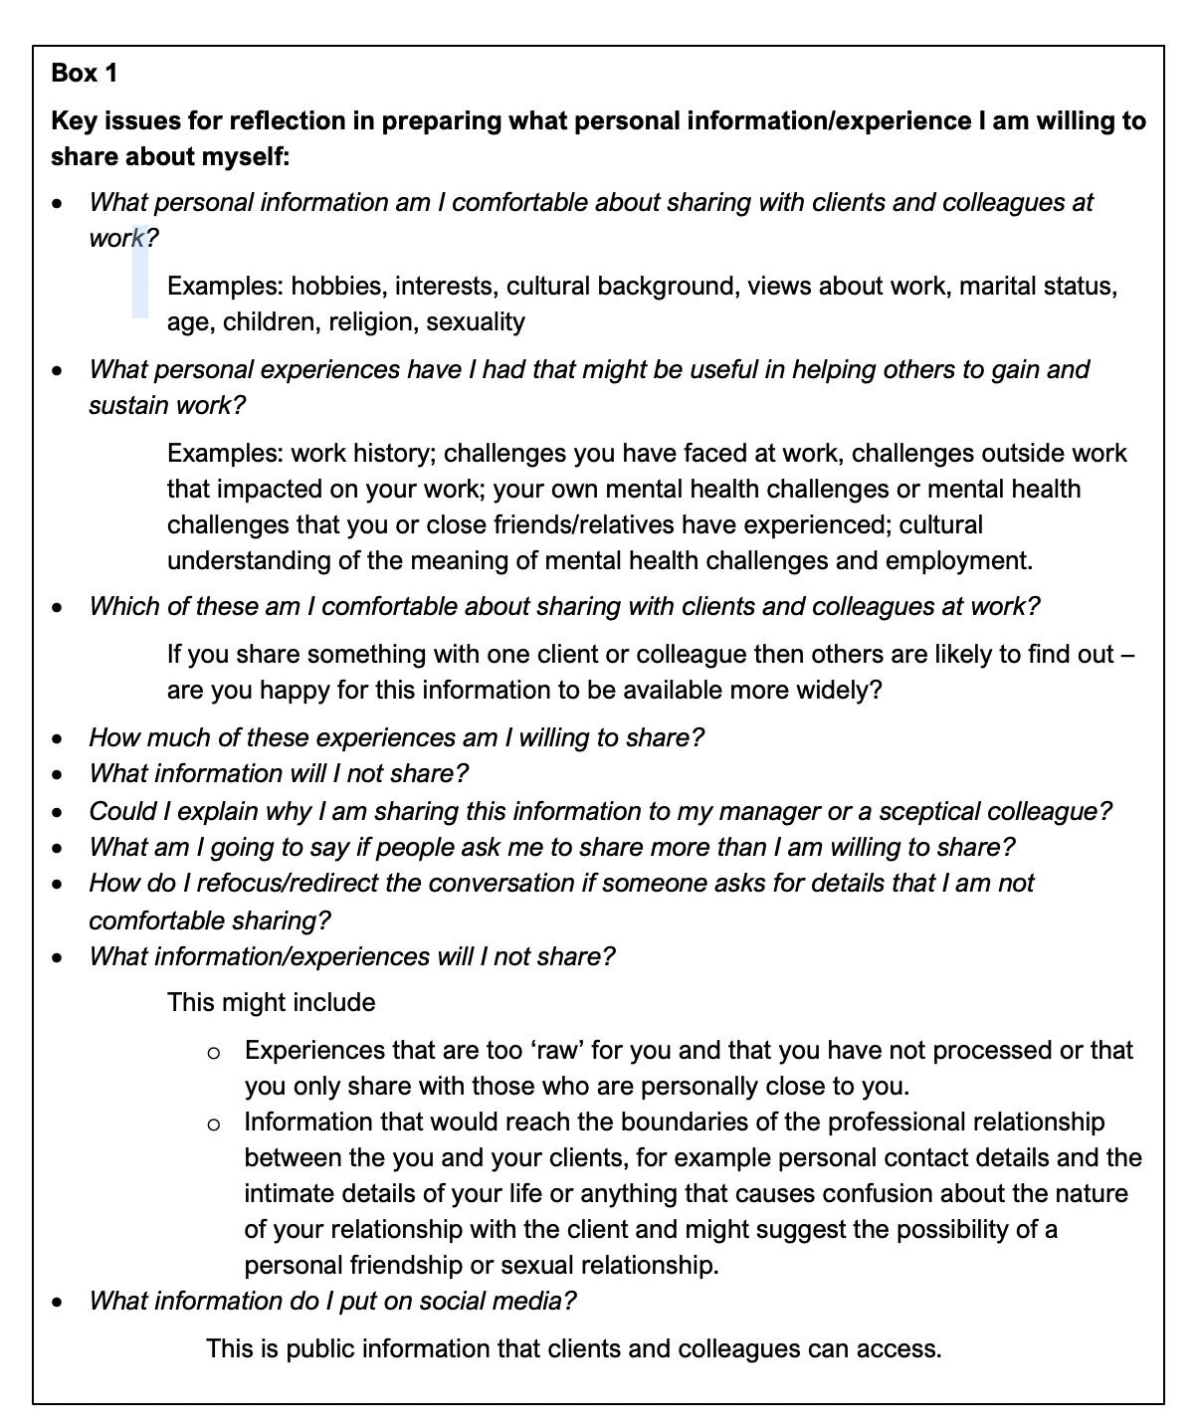
Key issues for reflection in preparing what personal information/experience I am willing to share about myself
.

Slide 21
Towards guidelines for sharing personal information and experience in IPS Practice
2. Decisions about sharing personal information and experience in individual interactions
What?
What personal information/experience do I have that might be useful to share?
Why might it be useful to share it?
Motivation for sharing?
When might it be relevant to share this personal information or experience?
Why might I share this personal information or experience now – what am I hoping to achieve?
How might I share the personal information or experience?
How much, how much time do I talk?
Am I assuming the person’s situation and feelings are the same as mine? (everyone’s situation is different)

Slide 22
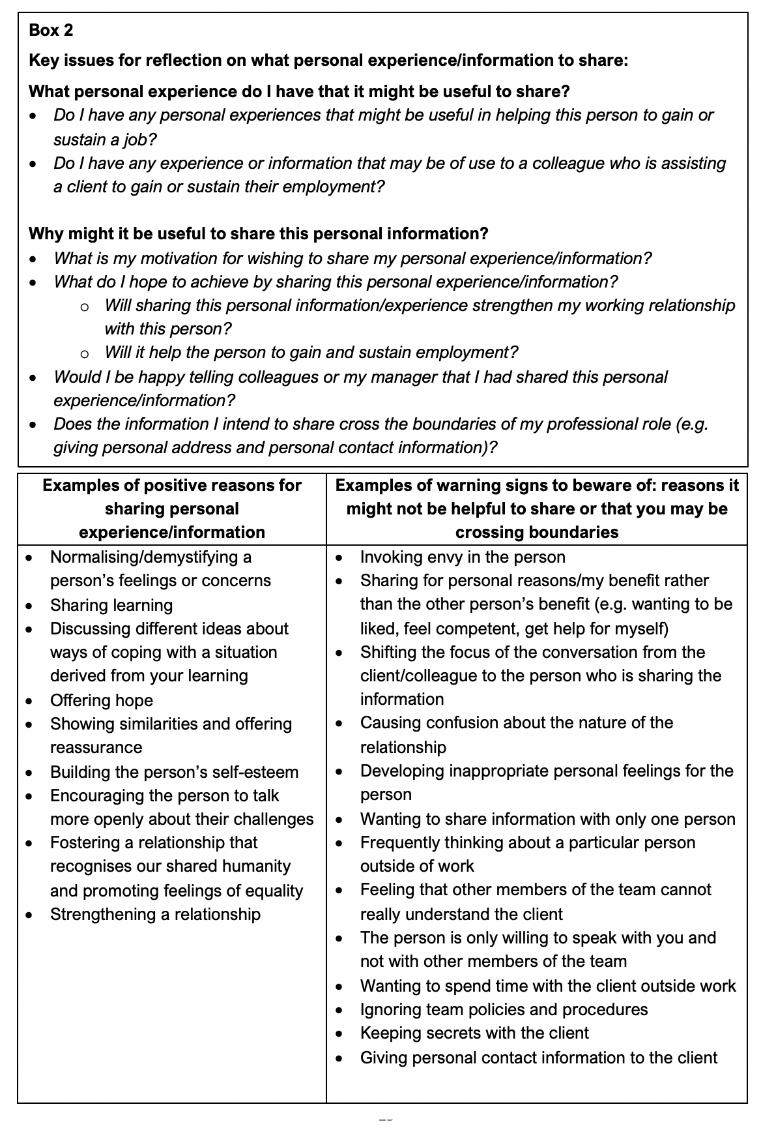
Decisions about sharing personal information and experience in individual interactions
.
Key issues for reflection on what personal information/experience to share

Slide 23
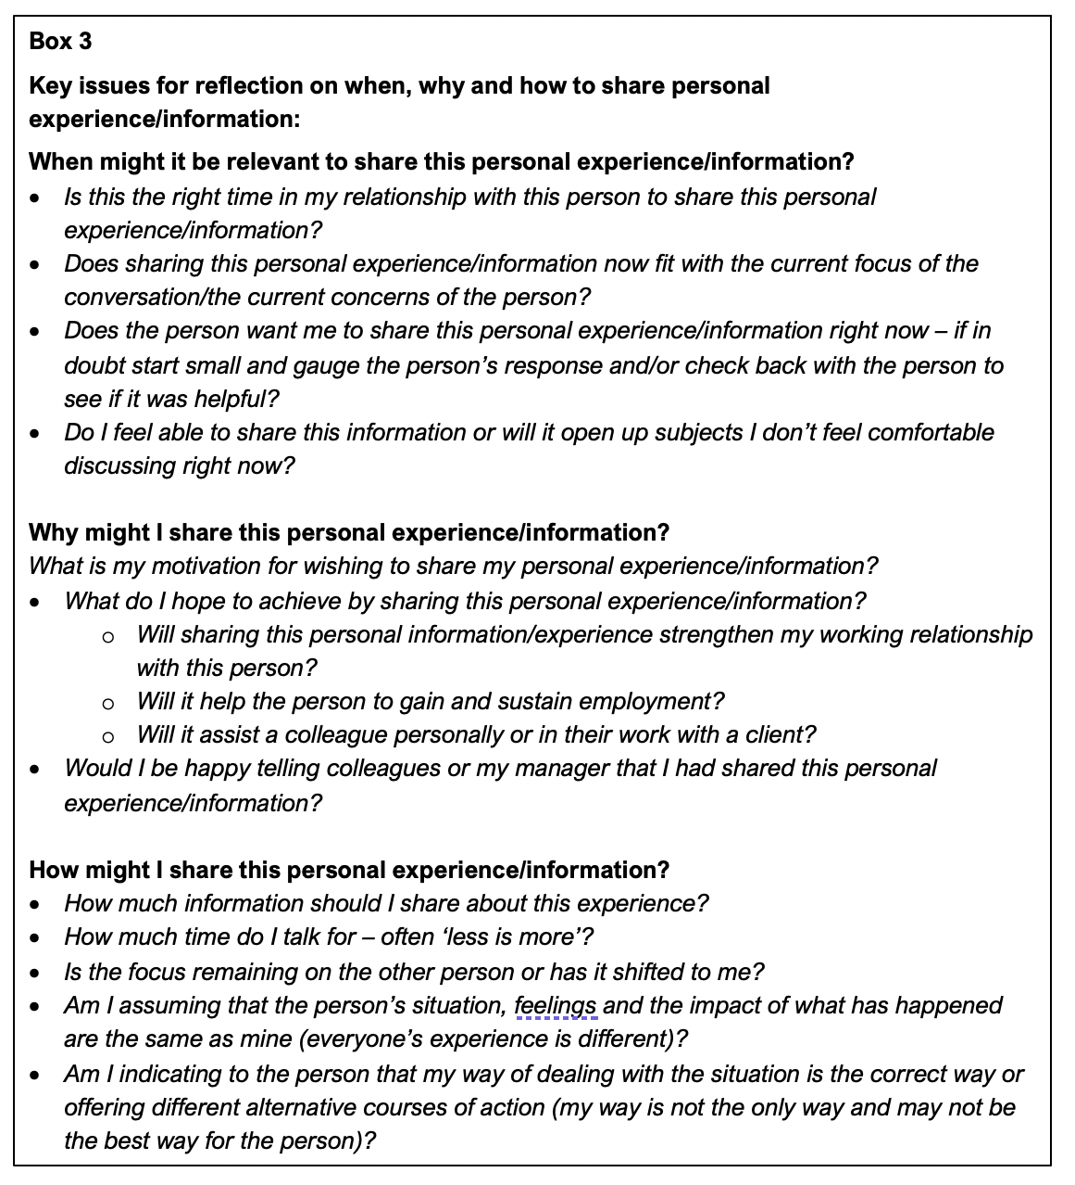
Decisions about sharing personal information and experience in individual interactions
Key issues for reflection on when, why and how to share personal information/ experience

Slide 24
Towards guidelines for sharing personal information and experience in IPS Practice 3. Reflection after sharing personal information
How did it go – impact on the person, our relationship, me?
What worked and what did not … and why?
What learning can I take from sharing my experience?

Slide 25
The importance of supervision in valuing and using personal information
Assisting practitioners to:
Think about what personal experience and information are they bringing to their work
How they feel about using this personal experience and information in their work
Make decisions about what personal information and experience they are willing and able to share with clients/colleagues that might be useful in their work
Prepare a brief biography of themselves to share with clients and colleagues
Think about why, when and how to share personal information and experience in the different facets of their work
Reflect on and learn from their sharing of personal information and experience
Understand relevant policies and procedures of their employing organisation

Slide 26
Building skills and creating a culture within the IPS Team and Service that values personal experience 1. The importance of leadership
Ensuring that operational policies make reference to the value and use of relevant personal information and experience
Modelling appropriate sharing of personal information and experience by sharing their own experience with team members
Creating expectations that everyone will use some of their personal information/experience in their work, for example
all staff preparing a brief biography and
these biographies being included in information about the service given to clients, recruits and potential recruits
Ensuring personal experience is addressed in supervision
While encouraging all staff to share relevant personal information and experience, considering the creation of lived experience specific ‘peer’ roles

Slide 27
Building skills and creating a culture within the IPS Team and Service that values personal experience 2. Other possible enablers
Organising seminars within IPS teams to discuss the value and use of personal experience in their work
‘Reflective practice’ sessions where staff can explore and reflect on their use of personal information and experience in their work
Explicitly including the ways in which the personal experience of practitioners has been/might be used in team meeting discussions of work with individual clients
Considering the value and use of personal experience in IPS Communities of Practice
Organising specific training sessions
Collecting examples of the value and use of personal experience in IPS practice to act as a resource for practitioners
Including the value and use of personal information and experience in Employment Specialist training and IPS Team Leader Training
Integrating use of personal experience in the promotion of IPS within clinical services
Promoting a culture in the organisation as a whole where personal experience is valued and used

Slide 28
Questions, comments, reflections …
How might you create/have you created an environment where your team value and use personal experience/information (alongside their professional skills) in their IPS practice?

Slide 29
Helping people with mental health challenges to gain and sustain employment is not easy – it is critical that we use all the expertise and experience available within our services
IPS practitioners come from diverse backgrounds and have a wide range of skills and experience, including personal experience of mental health challenges
Using personal experience alongside professional skills adds value to IPS practice and greatly increases the expertise available to the IPS team

